Slide 1
Maternal Healthcare Disparities
Tamera Hatfield MD,PhD
Associate Professor
Maternal Fetal Medicine
University of California, Irvine

Slide 2
WHO on Birth Equity
World Health Organization definition of respectful maternity care as a guiding principal: refers to care organized for and provided to all women and birthing people in a manner that maintains their dignity, privacy and confidentiality, ensures freedom from harm and mistreatment, and enables informed choice and continuous support during labor and childbirth, regardless of their race, ethnicity, nationality, gender, religion, sexuality, age, disability, HIV status, immigration status, housing status, income, or insurance status and type.

Slide 3
Shalon Irving’s story

Slide 4
Black Women
Black women are 22% more likely to die from heart disease
Black women are 71% more likely to die from cervical cancer
Black women are 243% more likely to die from pregnancy or childbirth related causes

Slide 5
Black Women
Are less likely to enter prenatal care early in pregnancy
Are Less likely to receive adequate care
Often receive lower quality care even with equal access to care and insurance coverage

Slide 7
Global Maternal Mortality

Slide 8
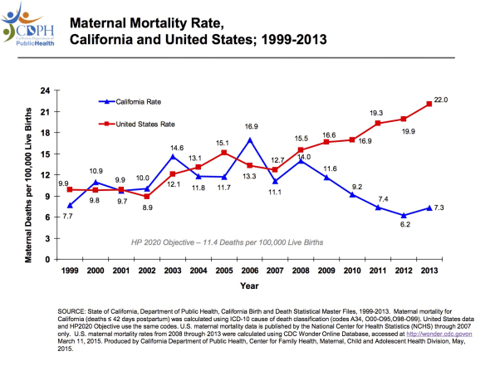

Slide 9
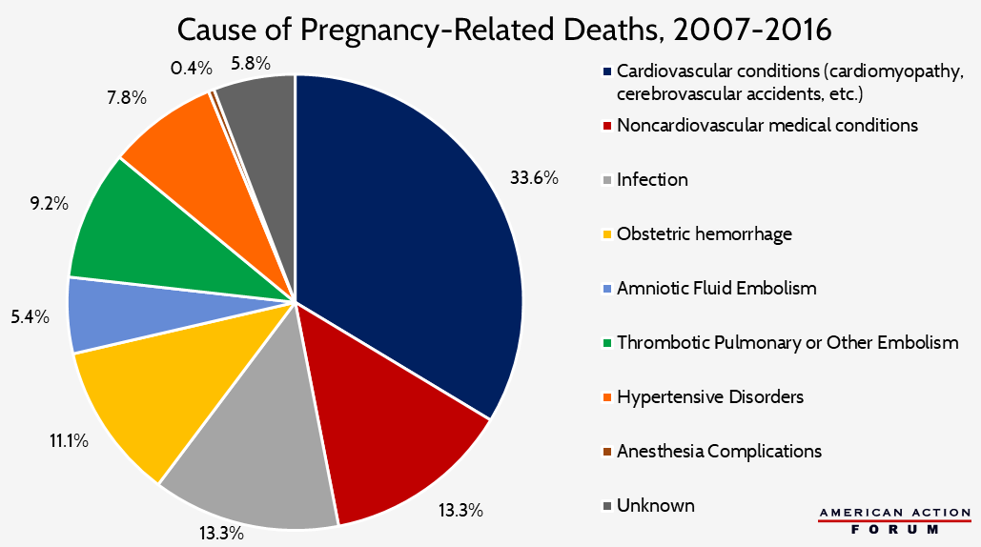

Slide 10
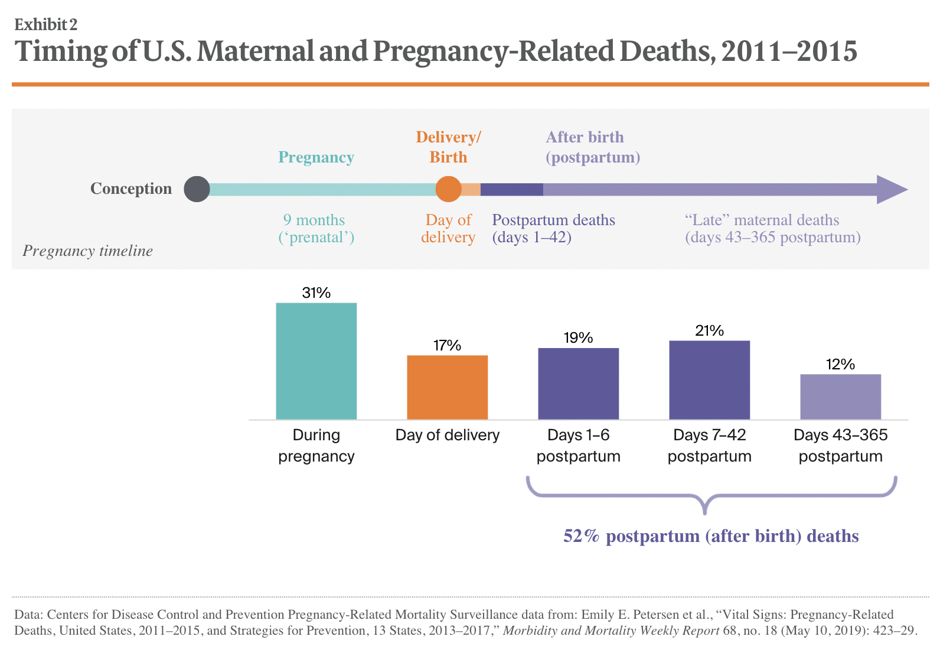

Slide 11
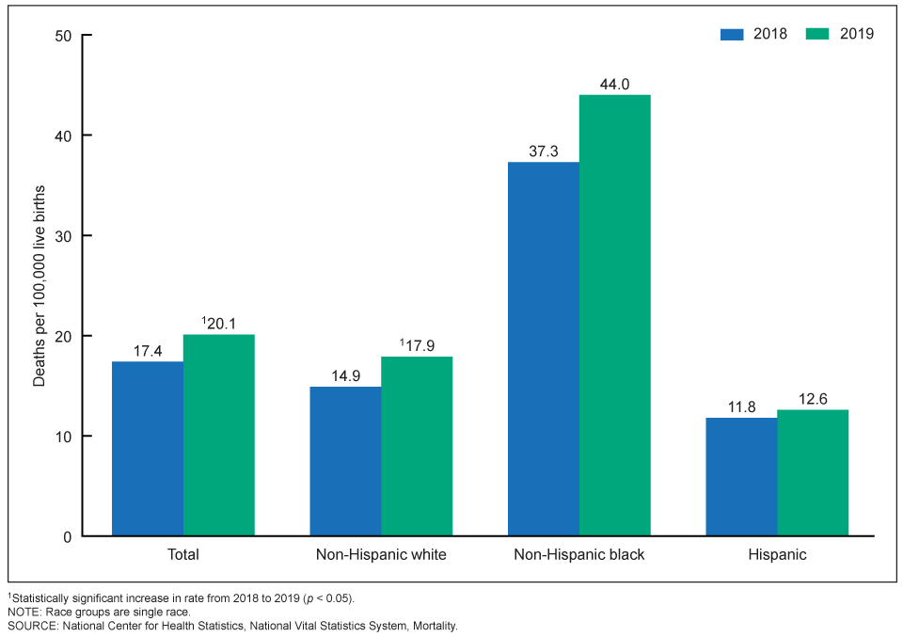

Slide 12
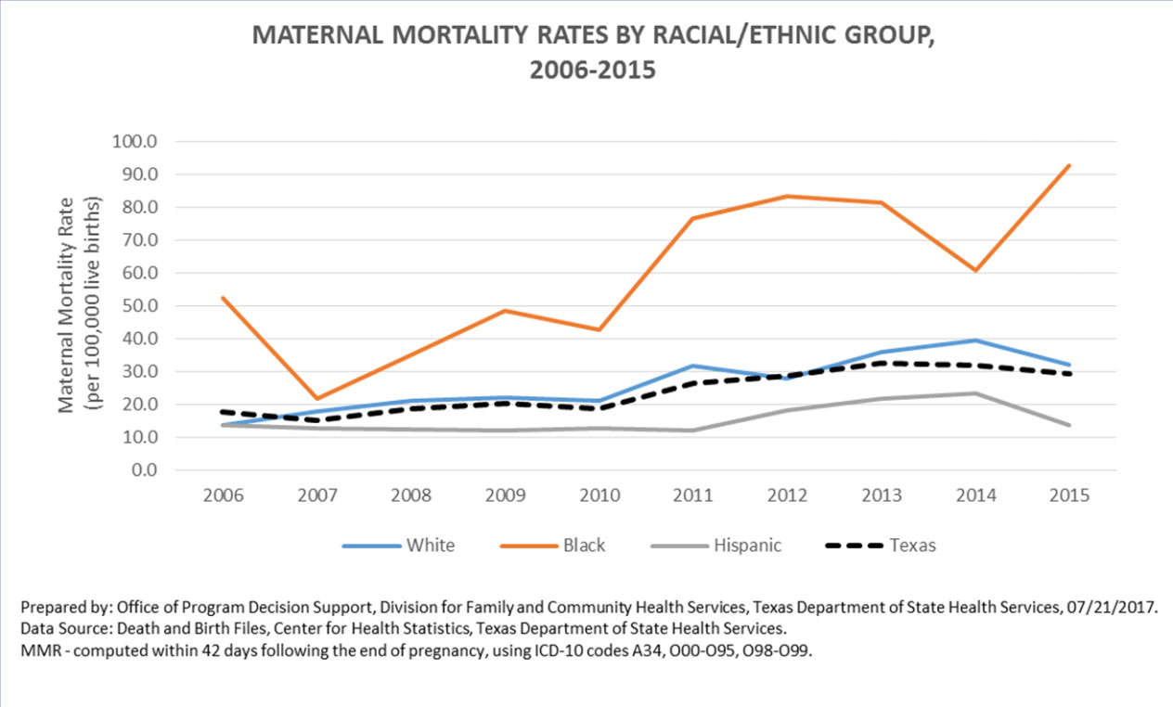

Slide 13
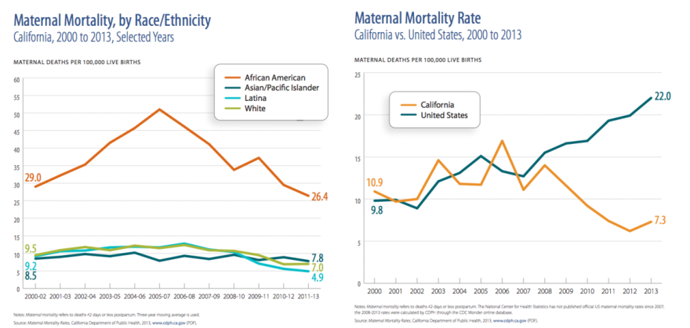

Slide 14
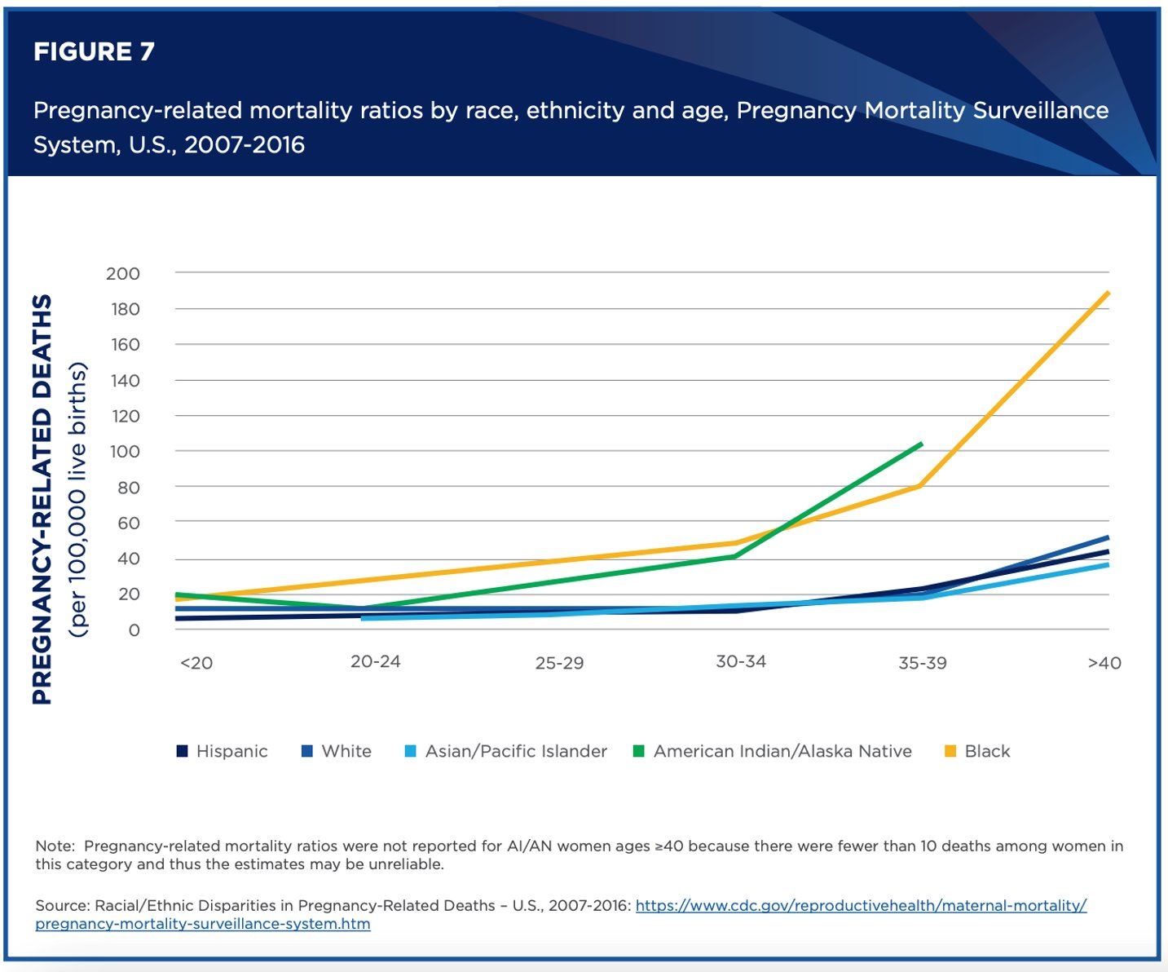

Slide 15
Weathering
A term coined by Arline Geronimus from the University of Michigan School of Public Health for stress induced health vulnerabilities
Leads to early onset chronic disease such as hypertension and diabetes
Her research suggests accelerated aging at the molecular level
Telomers (chromosomal markers of aging) appeared 7.5 years older than in their age matched white counterparts

Slide 16
Stress and Pregnancy
Linked to several adverse pregnancy outcomes
Most notably increased risk of preterm delivery
Black women are 49% more likely to deliver prematurely than whites and their babies are twice as likely to die before their first birthday compared to white babies

Slide 17
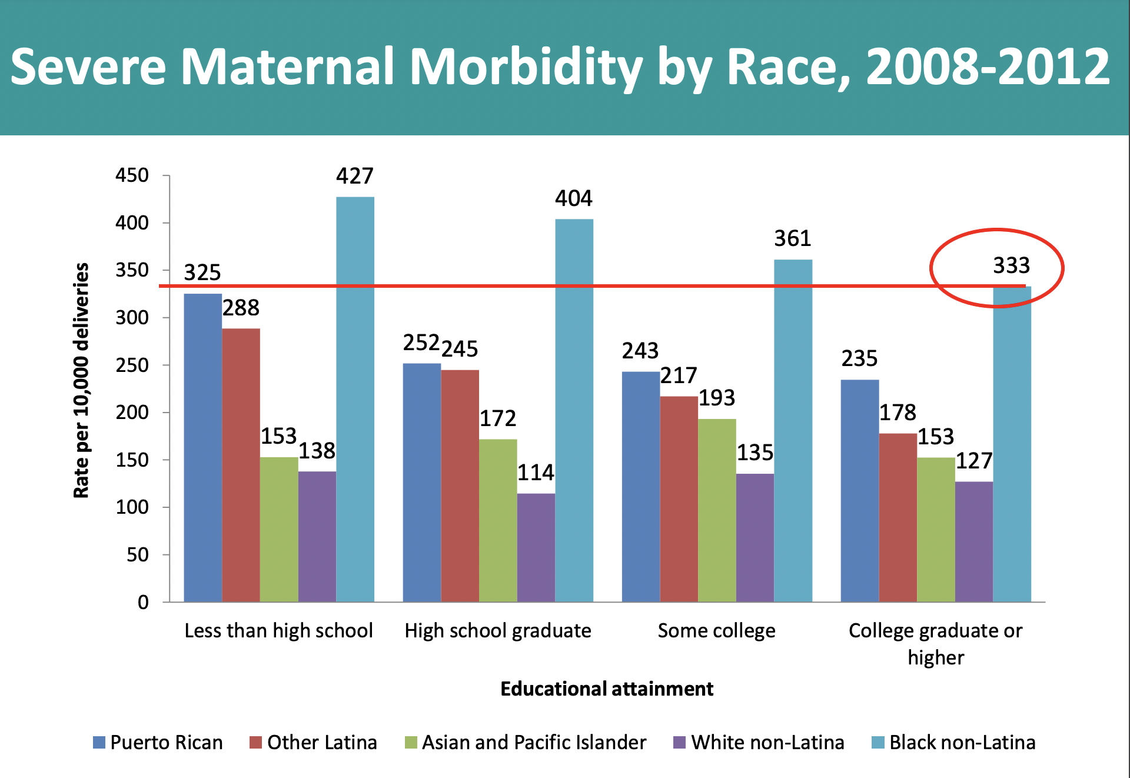

Slide 18
Factors Contributing to Health Care Disparities
Education
Access
Socioeconomic Status
Co-morbidities-HTN, DM, Obesity
Slavery health deficit
Implicit bias
Stereotype
Institutional and Societal Racism

Slide 19
Geography Matters
2.2 million women of childbearing age live in “maternity care deserts,” which are counties without a hospital, birth center or providers offering obstetric services
4.8 million women of childbearing age live in counties with limited access to maternity care.
Infants born in the southeastern U.S. are much more likely to be born early than in other parts of the country

Slide 20
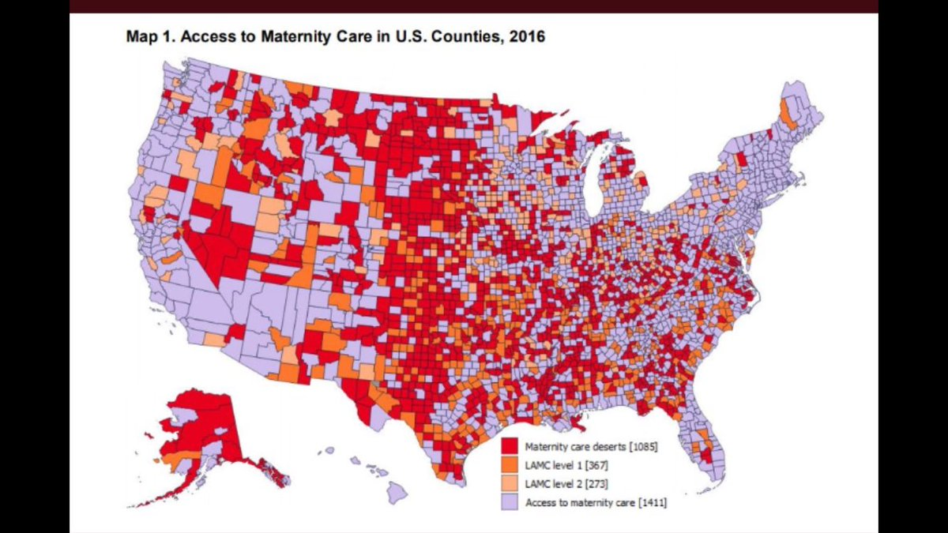

Slide 21
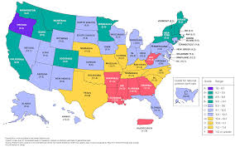

Slide 22
SDoH Contribute to wide health disparities and inequities
Safe housing, transportation, and neighborhoods
Racism, discrimination, and violence
Education, job opportunities, and income
Access to nutritious foods and physical activity opportunities
Polluted air and water
Language and literacy skills

Slide 25
Lost Opportunities
Lack of access to care
Delayed Diagnosis
Failure to recognize warning signs
Management of pre-existing conditions

Slide 27
Impact on patient care
Fear
Lack of trust
Lower self esteem
Internalized racism

Slide 28
Health Care Provider Responsibilities
STOP
Blaming the Victim
Ignoring/Denying Implicit Bias
Look
For Opportunities to empower others
For Evidence Based Practices
Listen
Without Judgement
With Empathy
Acknowledge
Race as a risk factor
SDoH in treatment plans

Slide 29
Health Care System’s Role For Equity in Care Delivery
Prioritize
Prioritize reducing inequities and promote projects that actively support anti-racist practices
Engage
Engage with external partners to advance equity work
Amplify
Amplify the voices of birthing persons in maternal equity and quality initiatives, with the goal of diverse and inclusive representation on committees
Promote
Promote learning about structural, institutional, and interpersonal racism in maternity care and apply these insights to our work as an organization toward creating a more equitable care model for maternal health

Slide 30
Legislative Efforts
2018: Preventing Maternal Deaths Act
Enabled through 2023 the continuation and expansion of data collection, research, and education.
Current Bill (Senate): Mothers and Offspring Mortality and Morbidity Awareness Act
Mandatory 1 year postpartum benefits.
Current Maternal Health Quality Improvement Act—specific to rural areas
Expansion of telehealth including funding to support the expansion.
Increases maternal care training in rural areas.

Slide 31
Racial Disparities Key Points
Black women experience maternal deaths at 3-4 times that of nonHispanic white women. The risk of maternal mortality among black women persists after controlling for socioeconomic status.
According to the Centers for Disease Control and Prevention, nearly 60% of maternal deaths in the United States are preventable and most (44%) occur within 42 days of the postpartum period.
Implicit bias likely plays a key role in racial healthcare disparities
Postpartum care is critical to addressing clinical complications and social determinants that prevent women from accessing adequate postpartum care

Slide 32
