Slide 1
Immigrant Health & Healthcare
Gloria Montiel, Ph.D.
AltaMed Institute for Health Equity &
Latino Health Access

Slide 2
Contents
Immigrants in the US
Immigrants and Health
Role of Social Determinants of Health in health outcomes
Impact of existing and proposed policy on Immigrant Health
Engagement in addressing SDoH

Slide 3
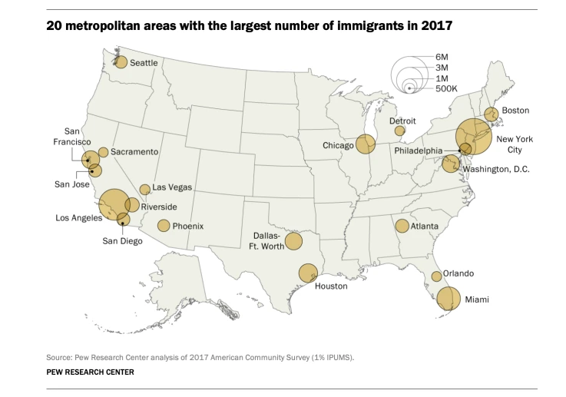
Immigrants in the US

Slide 4
44, 825, 855
immigrants Currently living in the U.s. Immigrants comprise 13.7% of the total US population.

Slide 5
Who immigrates to the US?
immigrants Currently living in the U.s. Immigrants comprise 13.7% of the total US population.

Slide 6
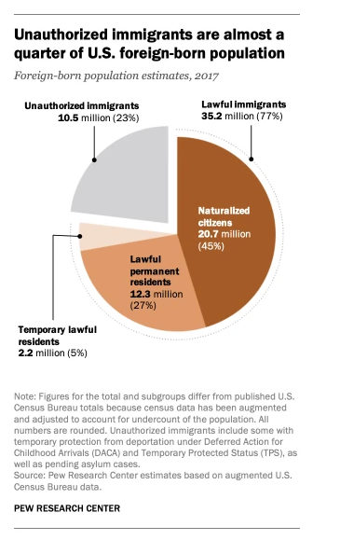
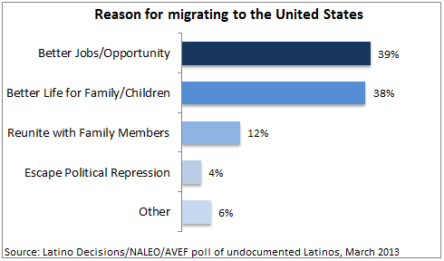
Types of Immigrants in the US
Lawful Permanent Resident (LPR) An LPR (someone with a “green card”) has permission to live and work in the United States, but is not eligible for certain benefits, such as voting and some social services.
Temporary Visitor, “Non-immigrants” A temporary visitor is someone who has permission from the government, usually in the form of a “visa” or in the form of protected status (TPS, DACA, Refugee) to live in the United States for a deliniated period of time and for a specific purpose.
Undocumented Immigrant An undocumented immigrant does not have permission to live or work in the United States and is at risk of deportation.

Slide 7
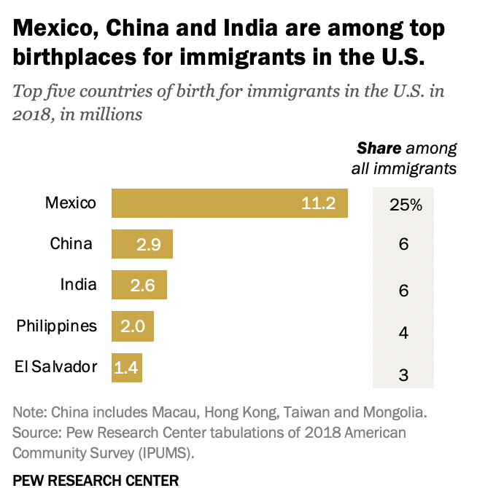
Immigrants in the US
Notes:
We know where a majority of immigrants are from

Slide 8
Immigrants in the US
The United States has more immigrants than any other country in the world.
Immigrants to the US are fairly young and due to more and more stringent immigration policies we know that they are staying longer in the US.
The average undocumented immigrant has been in the US for 15 years.
 | US | California
Immigrant Population | 44,825,855 | 10,653,414
Age
0-17 | 2,582,499 (5.8%) | 415,483 (3.9%)
18-24 | 2,983,232 (6.7%) | 532,670 (5%)
25-44 | 16,875,299 (37.9%) | 3,781,961 (35.5%)
45-64 | 15,138,791 (34%) | 4,037,643 (37.9%)
65+ | 6,990,559 (15.7) | 1,875,000 (17.6%)
Notes:
We know that people in their 20s and into their 40s are most likely to immigrate and stay through their mid-60s

Slide 9
Immigrants in the US breakdown by race
 | US | California
Immigrant Population | 44,525,855 | 10,653,414
Of One Race | 97.8% | 98.0%
White | 20,259,264 (45.5%) | 4,154,831 (39.0%)
Black or African American | 4,140,904 (9.30%) | 170,454 (1.60%)
American Indian and Alaskan Native | 178,103 (0.40%) | 42,613 (0.40%)
Asian | 12,066,506 (27.1%) | 3,664,774 (34.4%)
Native Hawaiian and Other Pacific Islander | 133,577 (0.30%) | 42,613 (0.40%)
Some Other Race | 6,767,929 (15.2%) | 2,354,404 (22.1%)
Hispanic or Latino Origin (of any race) | 19,724,953 (44.3%) | 5,220,172 (49.0%)
The population of immigrants in the US is very diverse, just about every country in the world is represented among U.S. immigrants.

Slide 10
immigrants and health

Slide 11
“Healthy Immigrant Effect”
The Healthy Immigrant Effect (HIE) refers to the fact that recent migrants are in better health than the nonmigrant population in the host country because of positive self selection.
According to NVSS(national vital statistic system) and NHIS(National Health Interview Survey), immigrants have better infant, child, and adult health and lower disability and mortality rates than the US-born, with immigrant health patterns varying across racial/ethnic groups.
Immigrant children and adults, however, fare substantially worse than the US-born in health insurance coverage and access to preventive health services.
Notes:
Even though research is well-documented and supports the theory of the “healthy immigrant effect,” “immigrant paradox,” or “immi- grant advantage,” such that immigrants are generally healthy on entering the United States, a vast amount of the literature also suggest that with time in the United States, the adaptation process becomes the trajectory for deteriorating health and chronic disease development
The NVSS and NHIS, the two most important data systems, include a wide range of health variables and many racial/ethnic and immigrant groups. Immigrants live 3.4 years longer than the US-born, with a life expectancy ranging from 83.0 years for Asian/Pacific Islander immigrants to 69.2 years for US-born blacks. Overall, immigrants have better infant, child, and adult health and lower disability and mortality rates than the US-born, with immigrant health patterns varying across racial/ethnic groups. Immigrant children and adults, however, fare substantially worse than the US-born in health insurance coverage and access to preventive health services.
Issues with the data (NHIS), (NVSS), During household interviews, NHIS collects information on the demographic and socioeconomic characteristics of respondents, in addition to information on activity limitation, illnesses, injuries, chronic conditions, health insurance coverage (or lack thereof), utilization of health care, and other health topics.

Slide 12
Issues with the “Healthy Immigrant effect” Literature
Gaps in the data that is at the core of this theory
Immigrants, especially undocumented or formally undocumented immigrants, live in culture of fear and are not likely to complete household interview surveys
It mostly reflects the health of immigrants upon entry to the US or a few years post-entry, it does not mean that immigrants stay “healthier” than their native-born counterparts
It does not consider the vastly different situations that immigrants live in once in the US

Slide 13
Comorbidities in immigrants and impact of immigrating on health
In a national evaluation of health conditions in immigrant populations, nearly a third (27.7%) of those from Mexico, the Caribbean, and Central America had hypertension, 71.5% had obesity, and 9.6% had diabetes, compared with the age-adjusted prevalence of 45.4%, 42.4%, and 8.2%, respectively, in the US general population
Depending on their mode of entry into the US, many immigrants may be at risk for excessive stress related to poverty, trauma, and poor social support, which leads to mental health conditions such as post-traumatic stress disorder, depression, and anxiety.

Slide 14
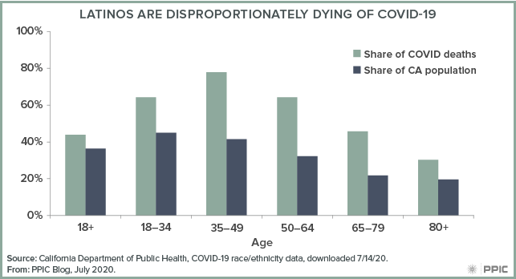
COVID-19
Data on how COVID-19 is impacting immigrants is difficult to find but we do know that COVID-19 is disproportionately affecting communities of color in California and across the country.
37% of California’s Latinx population is foreign born and latinx people across California, especially those lacking access to quality healthcare are being impacted by COVID at higher and more fatal rates

Slide 15
“As of 2017, non-citizen U.S. residents, including undocumented individuals and legal permanent residents, make up 7% of the US population but approximately one quarter of the U.S. uninsured population […] In California, 39% of undocumented individuals lack a usual source of healthcare other than the Emergency Department.” Samra et. al (2019)

Slide 16
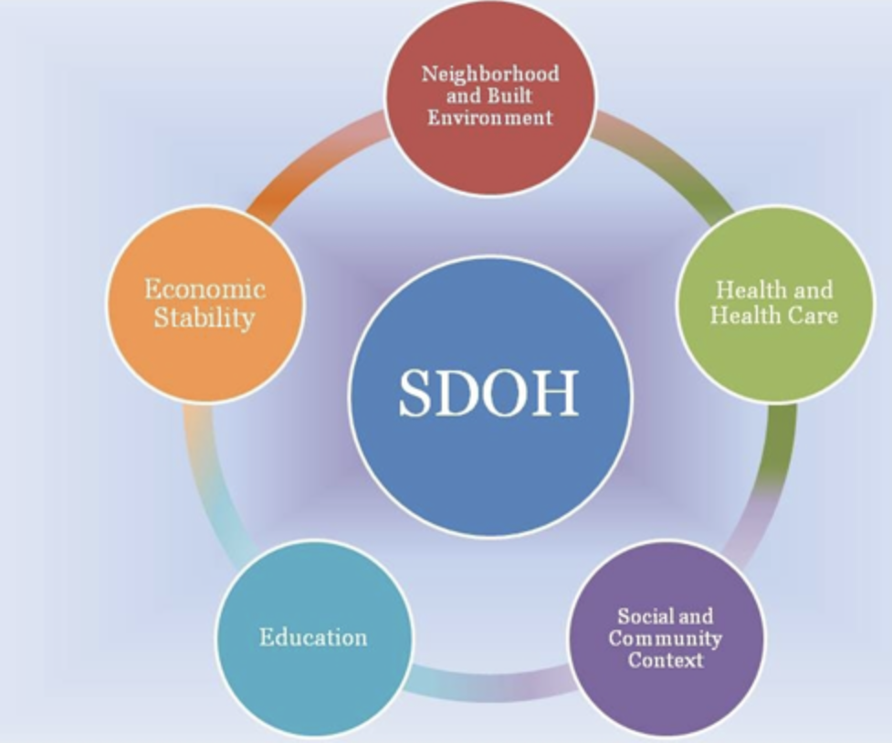
Role of Social Determinants of Health

Slide 17
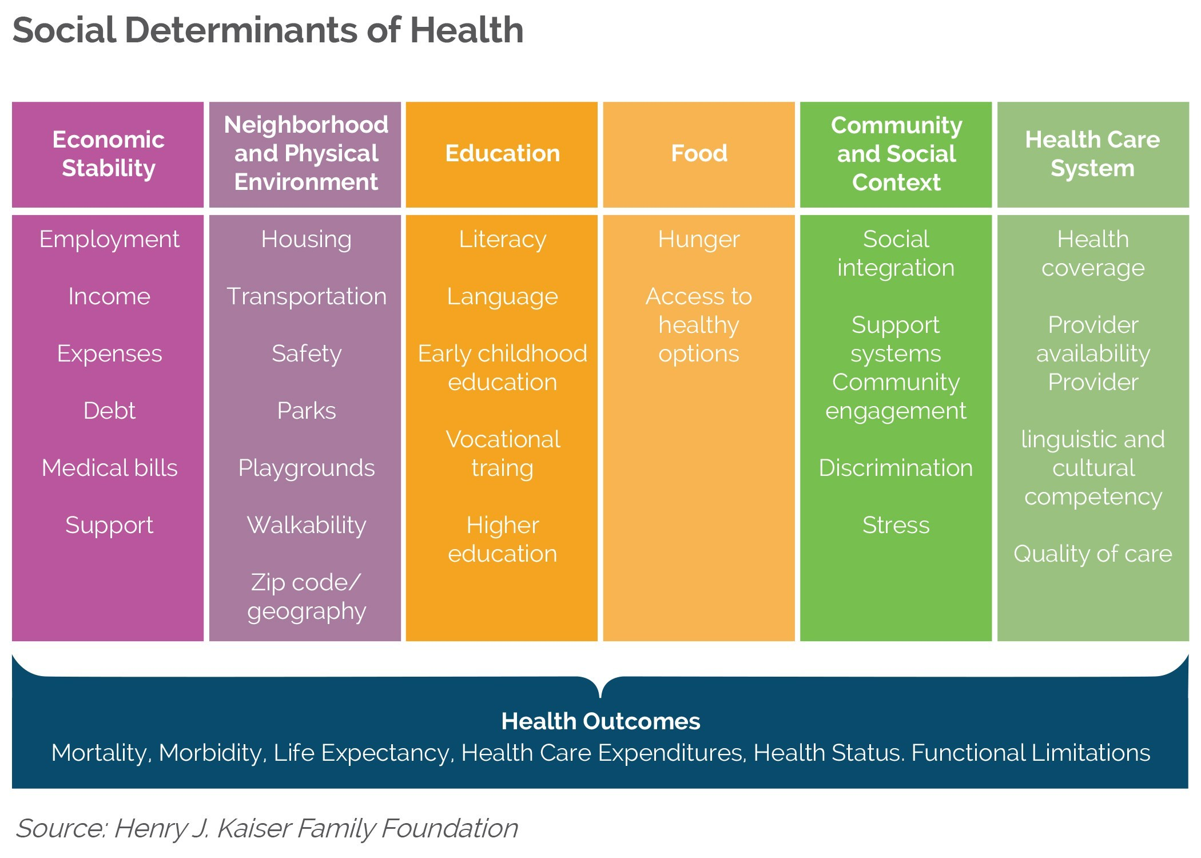
Social Determinants of health
Social determinants of health are conditions in the environments in which people are born, live, learn, work, play, worship, and age that affect a wide range of health, functioning, and quality-of-life outcomes and risks.

Slide 18
Immigration Status as a significant Social Determinant of health
Studies have shown that, compared to the U.S.-born population, immigrants and their U.S.-born children typically have lower rates of health insurance, use less health care, and receive lower quality of care
Their vulnerable position is impacted by Social Determinants of Health such as
socioeconomic background
immigration status
limited English proficiency
federal, state, and local policies on access to publicly funded health care
residential location;
stigma and marginalization

Slide 19
“When people in America are forced to live in fear because of their immigration status, their health and the health of our nation suffers.” – Immigration, Healthcare and health, Robert Wood Johnson Foundation

Slide 20
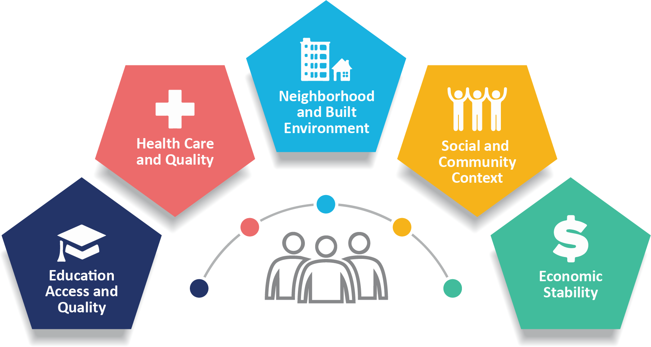
Economic Stability and food
Undocumented immigrants are nearly twice as likely as the overall U.S. population to be food insecure (24 percent compared to 14 percent).
despite living and working here long-term, many undocumented immigrants are still likely to hold low-wage jobs with few or no benefits. This, combined with the lack of access to safety net programs, a greater risk of unsafe working conditions, weaker health care, and the risk of being detained and deported all contribute to higher levels of hunger and poverty.
Ineligibility for Safety Net Programs
Families can pay as much as $10,000 in immigration court fees from raids and deportations—more than half the income of a low-wage worker.
Notes:
Source1: https://www.kff.org/racial-equity-and-health-policy/fact-sheet/health-coverage-of-immigrants/

Slide 21
Lack of access to health insurance and care
In a 2018 Kaiser Permanente report showed that among the nonelderly population:
23% of lawfully present immigrants and 45% of undocumented immigrants were uninsured 45%
compared to the 9% of US citizens who were noninsured
Moreover, among citizen children, those with at least one non-citizen parent are more likely to be uninsured compared to those with citizen parents (8% vs. 4%).

Slide 23
Lack of access to health insurance and care
In a 2018 Kaiser Permanente report showed that among the nonelderly population:
23% of lawfully present immigrants and 45% of undocumented immigrants were uninsured 45%
compared to the 9% of US citizens who were noninsured
Moreover, among citizen children, those with at least one non-citizen parent are more likely to be uninsured compared to those with citizen parents (8% vs. 4%).

Slide 24
Barriers to Health Insurance and care
Limited Access to Coverage
Cultural, linguistic and outreach gaps perpetuate enrollment barriers for eligible immigrants
Policies like “Public Charge” and a general culture of fear stops families from enrolling in programs, even for citizen children
Notes:
Limited access to coverage: uninsured, nonelderlyimmigrants are less likely to have jobs that provide insurance and more likely to be low-income income (lack of access to private coverage), undocumented immigrants do not qualify for federal coverage ( including purchasing insurance through the ACA) or (in most states) state coverage, Lawfully present immigrants may qualify for Medicaid and CHIP, but are subject to certain eligibility restrictions.

Slide 25
Existing and proposed policy that can impact immigrant Health
Look in the slide notes below for topics to consider talking about
Notes:
Consider talking about:
Interventions
Challenges of measuring value of interventions

Slide 26
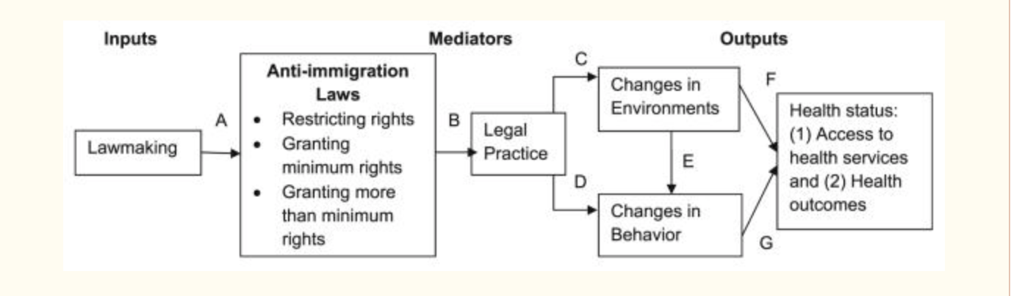
How policy impacts the health of immigrants

Slide 27
Types of policy that impact immigrant health
General Immigration policy
DACA
TPS
Deportation policies
Healthcare policy
Access to testing for COVID-19 and testing
Immigrants are often excluded from health insurance reform and even from patient protection law in some states
Health4All

Slide 28
How do we address these issues
These issues require systems and environmental change but there are steps we can take to ensure that all immigrants feel like they can access healthcare if they need it:
Cultural shift in the medical field in order to reach these communities
Culturally competent care
Linguistically accessible care
Outreach into communities

Slide 29
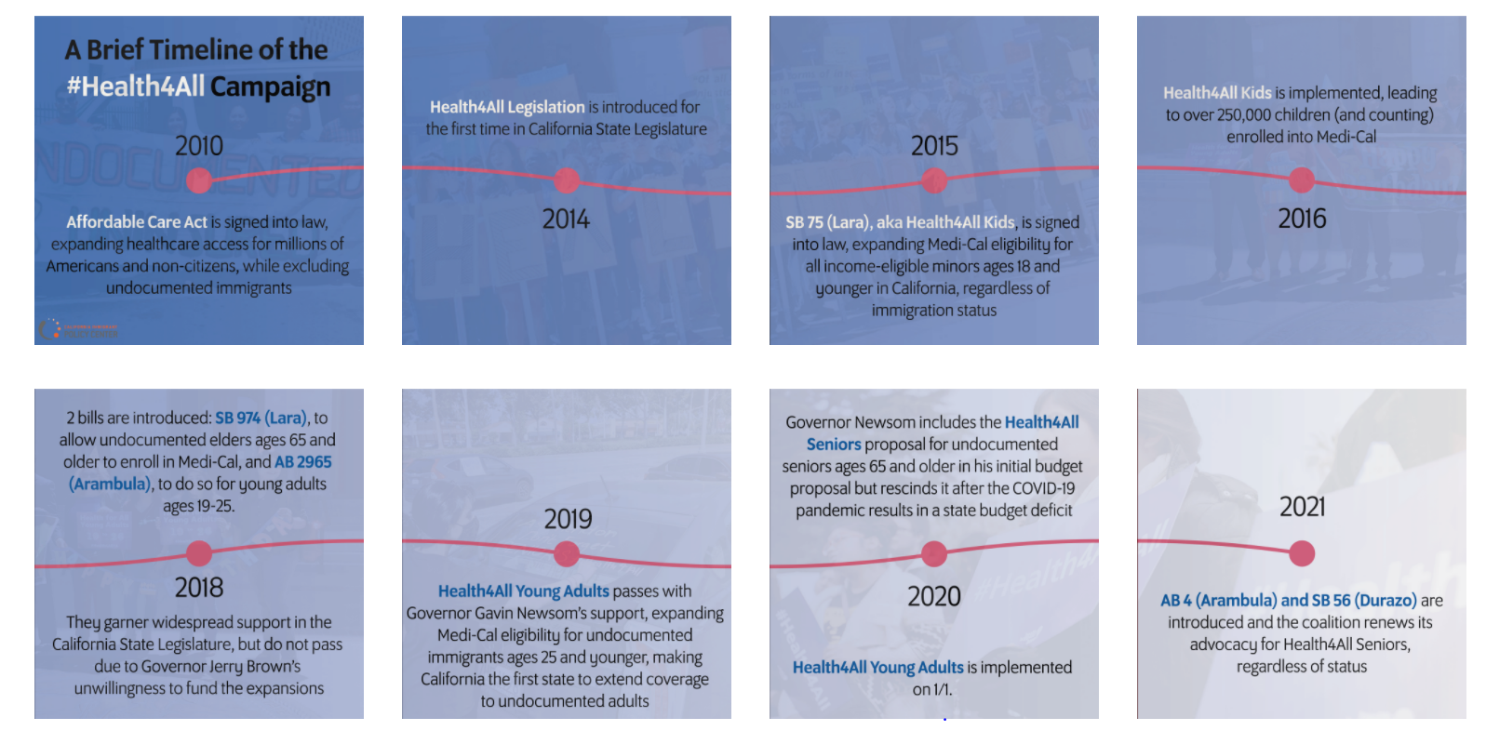
Health4All

Slide 30
Our work
Access to healthcare for all, regardless of immigration status
Sliding scale medical services
Civic engagement
Community-led advocacy
Community-led research

Slide 31
Thank you!

