Slide 1
Developmental Disabilities and Disparities
Peter J Chung, MD, FAAP
Associate Clinical Professor of Pediatrics
University of California-Irvine
Medical Director, the Center for Autism & Neurodevelopmental Disorders

Slide 2
Learning Objectives
Define a developmental disability and provide three examples
Describe how developmental disabilities can impact health care disparities
Name three ways a health care provider can help address healthcare disparities in patients with developmental disabilities

Slide 3
Outline
Defining and exploring Developmental Disabilities
Clinical overview of common developmental disabilities
Historical context
Current disparity data
Conservatorship/guardianship
Recommendations
Individual
Educational
Policy
Resources

Slide 4
Poll

Slide 5
What is a Developmental Disability?
“Developmental disabilities are a group of conditions due to an impairment in physical, learning, language, or behavior areas. These conditions begin during the developmental period, may impact day-to-day functioning, and usually last throughout a person’s lifetime.”
Affects 17% of US children age 3-17 years
Examples:
Attention Deficit/Hyperactivity Disorder
Autism Spectrum Disorder
Cerebral Palsy
Intellectual Disability
Learning Disability
Hearing and Vision Impairment

Slide 6
Attention Deficit/Hyperactivity Disorder
Persistent patterns of inattention/distractibility and/or hyperactivity/impulsivity
Presentation may be primary inattentive, hyperactive/impulsive, or combined
(Some) symptoms must be persistently present and impairing (mild ADHD may be diagnosed after 12 years of age)
Symptoms present in more than one setting
Occurs in 7-8% of children and adolescents

Slide 7
ADHD: Neurobiology
Related to dysmaturity of the pre-frontal lobe (lagging 3-5 years behind chronological age)
Commonly deficient in executive functioning
Working (short-term) memory
Mental flexibility
Emotional regulation
Task prioritization

Slide 8
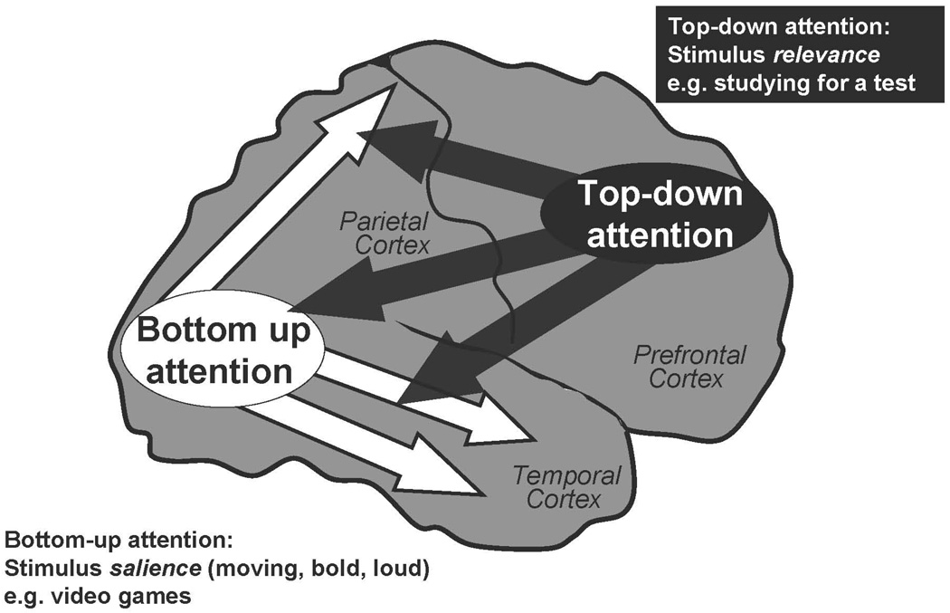

Slide 9
ADHD: Comorbidities
Other neurodevelopmental disorders
Autism spectrum disorder
Intellectual Disability
Learning disorders
Mental health disorders
Depression
Anxiety
Oppositional defiant disorder
Chronic medical conditions
Fetal alcohol spectrum disorder
Epilepsy
Genetic conditions
Social Determinants of Health
Barbaresi, et al 2020

Slide 10
ADHD: Life Trajectory
Commonly experience social issues in childhood (rejection, bully/victimization)
Approximately 1/3 of children with ADHD will continue taking medication as adults, although studies suggest symptoms persist in 35-65%
Childhood ADHD associated with increase rates of negative outcomes in adults
Substance use/abuse
Educational problems (school drop-out)
Higher co-morbid psychiatric conditions
Vocational issues (more likely to be fired/laid off, less hourly wages)
Teen pregnancy
Criminal behavior
Suicide attempts
Owens 2015, Kuriyan 2013

Slide 11
Autism Spectrum Disorder
Neurodevelopmental disorder marked by 1) deficiencies in social communication, cognition, and interaction AND 2) restrictive, repetitive patterns of behavior, interest, or activities
Manifestations and severity can vary between individuals and across time
Social communication: may have very little interest in others or may desire connection but struggle with social filtering/adjusting context or theory of mind
RRB: may get “stuck” on topics, rigidity with any change, very specific about certain routines, extreme sensitivity or insensitivity to sensory input

Slide 12
ASD: Prevalence
Current prevalence
1 in 44 children nationally
1 in 26 children in California
Historically more common in white vs. minority population
Rates have been increasing since surveillance began across all SES and racial/ethnic groups
Male to female ratio roughly 4:1
White and Black children were 1.2x more likely to be identified with ASD than Hispanic children
Values indicate prevalence per 1,000 children
ADDM

Slide 13
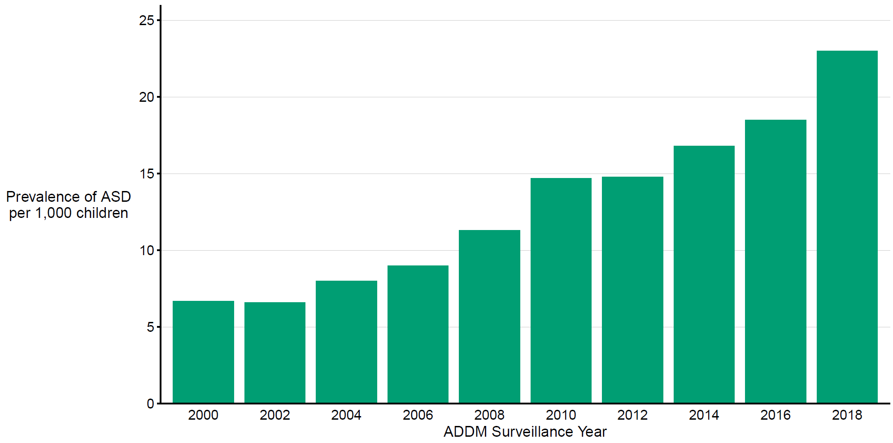
Prevalence of autism spectrum disorder per 1,000 children aged 8 years, by surveillance year Autism and Developmental Disabilities Monitoring Network, 2000–2018

Slide 14
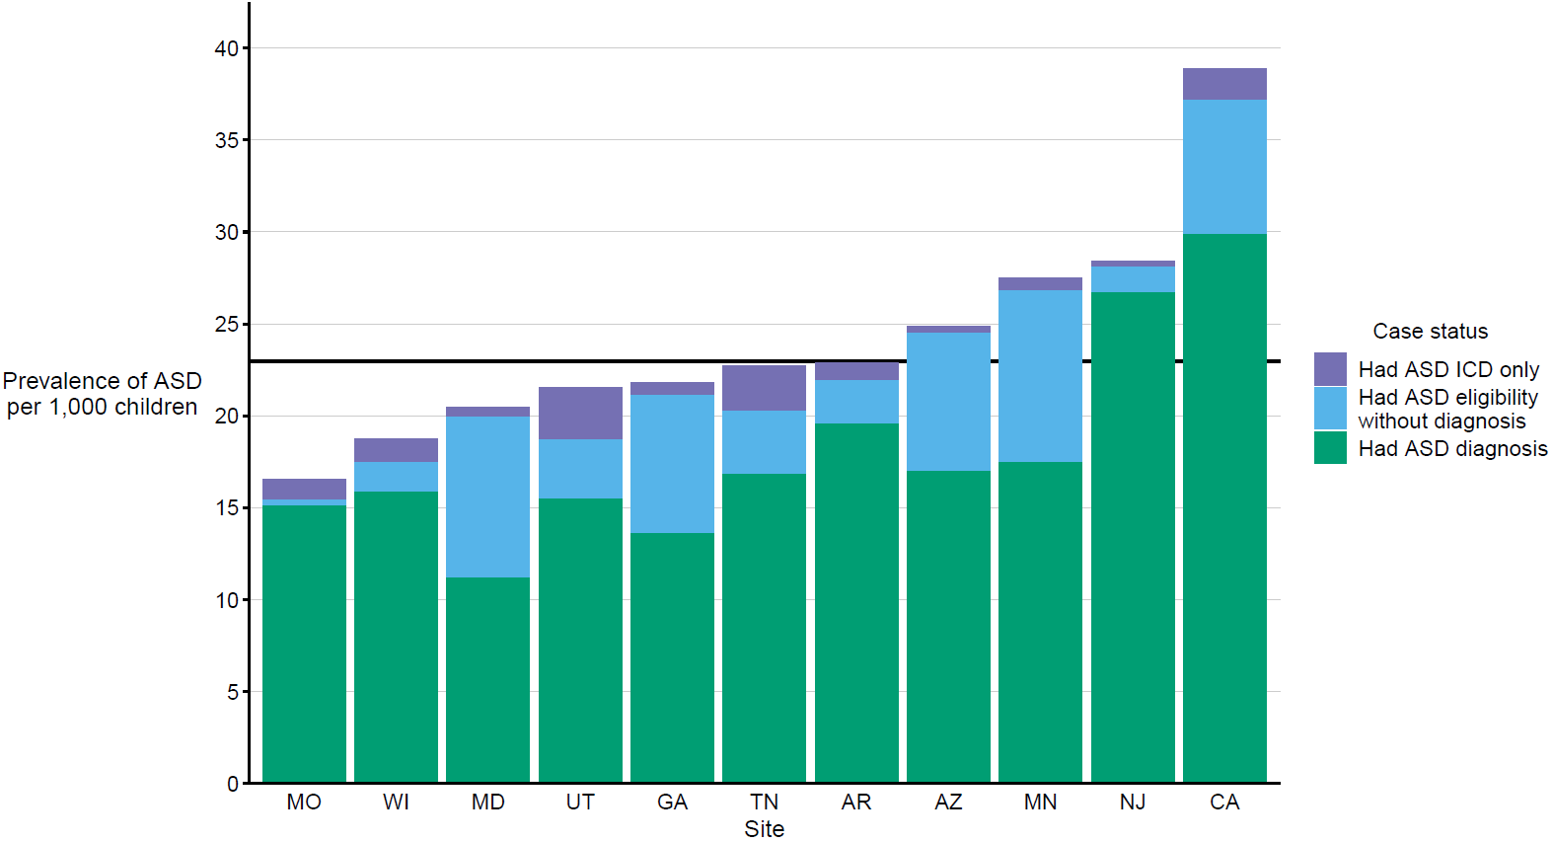
Prevalence* of autism spectrum disorder per 1,000 children aged 8 years, by identification type and site Autism and Developmental Disabilities Monitoring Network, 11 sites, United States, 2018
* Horizontal line is the overall Autism and Developmental Disabilities Monitoring Network prevalence of 23.0 per 1,000 children aged 8 years. Children with documented
ASD statements could also have ASD classifications in special education or ASD ICD codes.

Slide 15
ASD: Neurobiology
Direct cause is still unknow, likely genetic (5-20% chance of recurrence)
No evidence to suggest parenting style is related (although can be seen in extreme cases, e.g. orphanages)
No evidence to suggest thimerosol or other vaccine components cause ASD
Approximately 25% of patients will show regression between 18-24 months of age
Some studies demonstrate increased white matter and larger head circumference, with more “local” connections (early brain overgrowth)

Slide 16
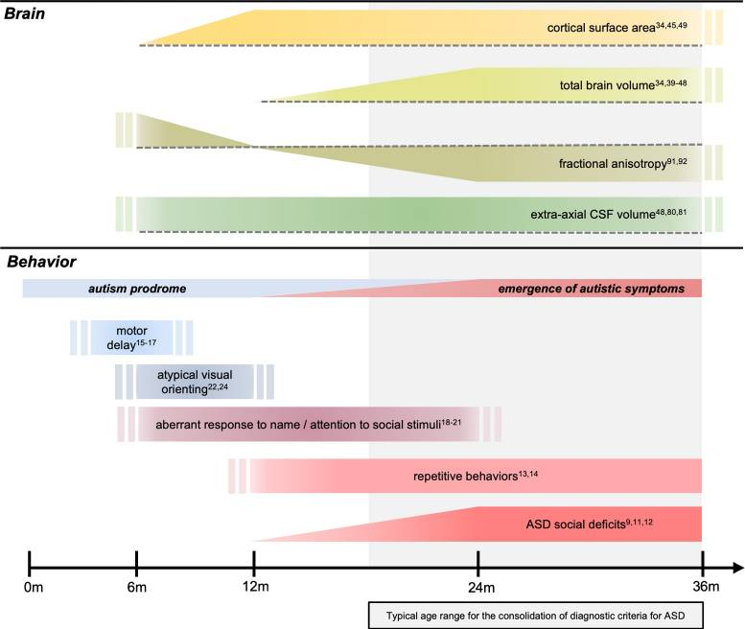
Neuroimaging Clin N Am. 2020 Feb; 30(1): 97–114.
Published online 2019 Nov 11. doi: 10.1016/j.nic.2019.09.009

Slide 17
ASD: Co-morbidities
Physical
Sleep issues
Constipation
Dental problems
Seizures
Psychological
ADHD
Learning disorders
Anxiety
Irritability/aggressive behavior
Intellectual disability

Slide 18
ASD: Life Trajectory
Prognosis and trajectory is difficult to establish at young age
>80% of children diagnosed at <3 years of age will retain diagnosis
~9% of children diagnosed in early childhood no longer meet criteria for ASD in adulthood (but may be diagnosed with other conditions like OCD or ADHD)
DSM-V three levels of severity (requiring support, requiring substantial support, and requiring very substantial support) but levels are subjective and non-prognostic
Hyman 2020

Slide 19
Cerebral Palsy: Overview
Non-progressive motor disorder resulting from injury to the developing brain
Causes:
Gene mutations
Maternal or infant infection
Fetal stroke
Traumatic head injury
Hypoxic brain injury
Overall prevalence: 1-4 per 1000 children, relatively stable over time

Slide 20
Cerebral Palsy: Neurobiology
Area of injury determines cerebral palsy type
Spastic/hypertonic (most common, ~80%): motor cortex
Dyskinetic: basal ganglia
Ataxic: cerebellum
Spasticity: hypertonic/stiff muscles which inhibit movement
hemiplegic, diplegic, quadriplegic
Dyskinetic: dystonia (twisting), athetosis (writhing), and chorea (dance-like)
Ataxic: tremors and poor balance
Vitrikas et al 2020

Slide 21
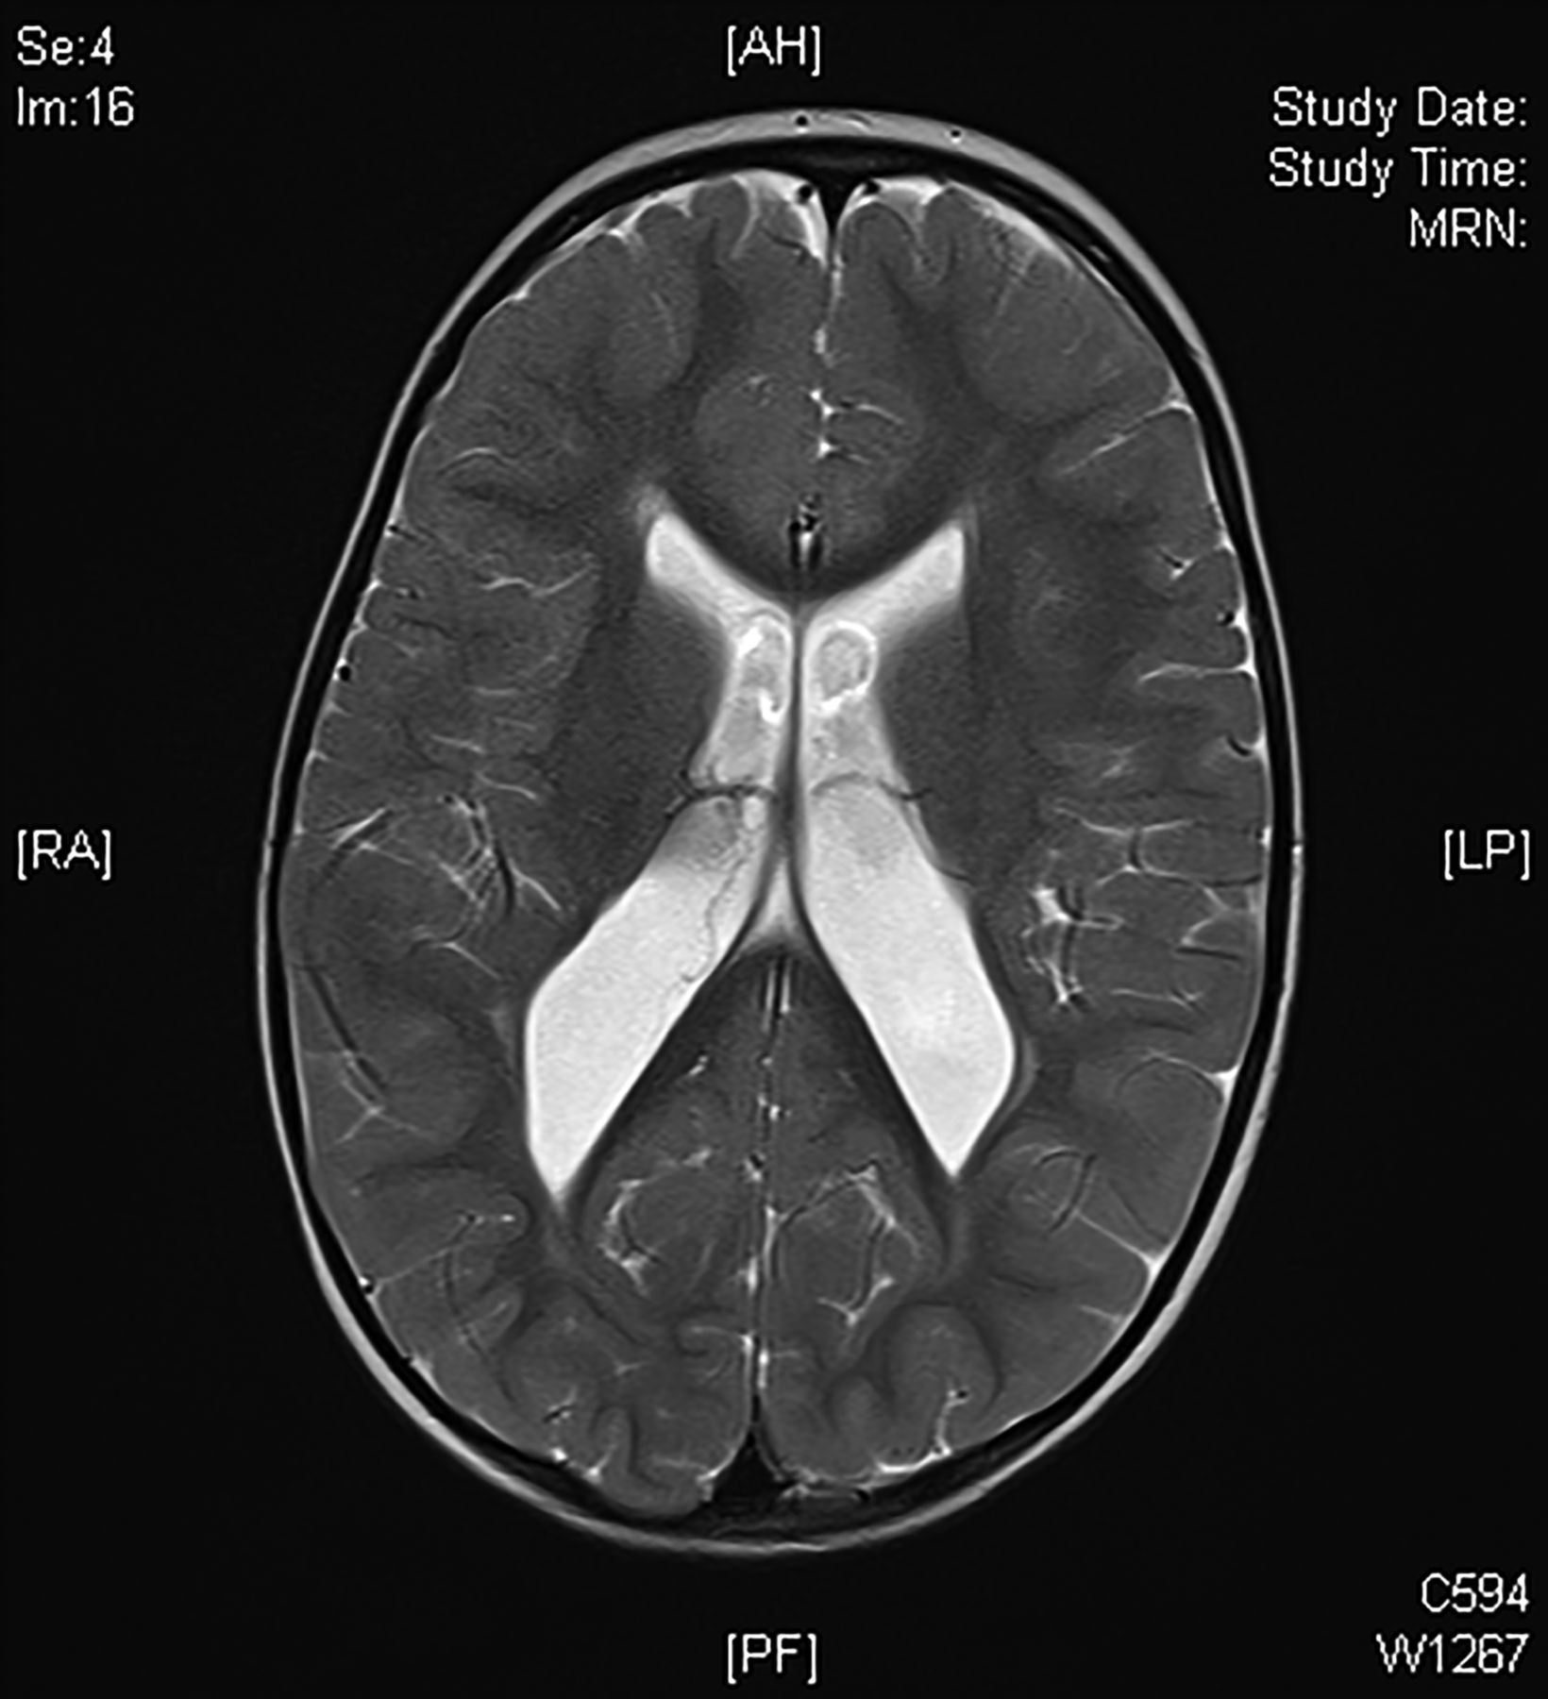
MR scan of brain (T2-weighted) showing periventricular leukomalacia associated with preterm (24–32 weeks gestation) injury to the brain.
Neil Wimalasundera, and Valerie L Stevenson Pract Neurol 2016;16:184-194
Notes:
MR scan of brain (T2-weighted) showing periventricular leukomalacia associated with preterm (24–32 weeks gestation) injury to the brain.

Slide 22
Cerebral Palsy: Co-morbidities
Associated conditions may include…
Intellectual disability,
Learning disorders
Seizures
Visual/hearing impairment
Communication limitations
GI problems (constipation, GERD)
Behavioral Problems
Likelihood of co-morbidity increases with CP severity

Slide 23
Cerebral Palsy: Life Trajectory
Outcomes broadly dependent on severity of underlying symptoms
Pain/mobility may affect walking and self-care
Lower rates of educational achievement and competitive employment
Higher rates of independent living if provided personal assistance aide
1 in 8 with domestic partner

Slide 24
Gross Motor Functional Classification Scale (6-12 years)

Slide 25
American Association on Intellectual and Developmental Disabilities
Characterized by significant limitations in both intellectual functioning and in adaptive behavior, originating before the age of 22
Significant limitations in intellectual functioning, which means a full scale IQ standard score of approximately 2 (or more) standard deviations below the mean as measured with an appropriately-normed, standardized test of intelligence.
Significant limitations in adaptive behavior, which means a standard score of approximately 2 (or more) standard deviations below the mean measured with an appropriate and standardized test of adaptive behavior in one or more of the following domains: conceptual, social, or practical skills.
The primary purpose of the definition is to assist with the development of a rehabilitative plan
Can be syndromic or non-syndromic
Severity determined by supports needed
Intermittent (as-needed)
Limited (time-span sensitive)
Extensive (daily)
Pervasive (constant)

Slide 26
Domains of Intelligence
Intelligence testing can be completed as early as 2 years of age but is generally more stable at 5 years of age
Verbal Comprehension
Working Memory
Perceptual Reasoning
Quantitative Reasoning
Abstract Thought
Cognitive Efficacy
Adaptive functioning generally measured through caregiver survey or interview

Slide 27
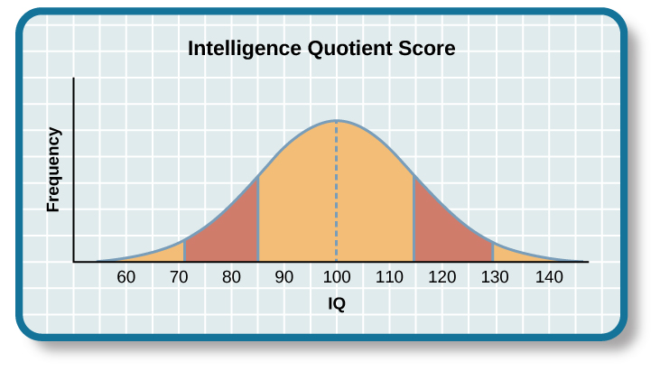
Domains of Intelligence
Verbal Comprehension
Working Memory
Perceptual Reasoning
Quantitative Reasoning
Abstract Thought
Cognitive Efficacy

Slide 28
Causes of ID
Genetic syndromes
Chromosomal disorders, e.g. Down syndrome
Contiguous gene deletions, e.g. Williams syndrome, Angelman syndrome
Single-gene deletions, e.g. Fragile X syndrome, Rett syndrome
Environmental causes
Alcohol and other teratogens
Prenatal infections
Early childhood central nervous system infections
Traumatic brain injury
Central nervous system disorders/malformations
Inborn errors of metabolism
Nutritional (e.g. severe malnutrition, chronic iron deficiency)
Not known
Purugganan 2018

Slide 29
Syndromic ID: phenotypes
Down syndrome: mild to moderate ID, usually weakness in verbal IQ
Fragile X: moderate ID, frequent learning disorders, ASD, anxiety
Rett Syndrome: language regression, ID, later motoric challenges
William Syndrome: mild to moderate ID, usually weakness in nonverbal IQ
Angelman: severe to profound ID, minimal language
Prader-Willi: variable levels of ID, psychiatric co-morbidity (anxiety, ASD, obsessive behaviors)
Purugganan 2018

Slide 30
ID Severity and Life Trajectory
Level of ID and % | Level of Support Needed | Associated Estimated IQ score | Projected Ultimate Academic Achievement
Mild (85%) | Intermittent | 55-70 | Up to 6th grade
Moderate (10%) | Limited | 40-55 | Up to 2nd grade
Severe (3-4%) | Extensive | 25-40 | Preschool level
Profound (1-2%) | Pervasive | <25 | --
Purugganan 2018

Slide 31
Outline
Defining and exploring Developmental Disabilities
Clinical overview of common developmental disabilities
Historical context
Current disparity data
Conservatorship/guardianship
Recommendations and resources

Slide 32
Historical Context: US in 18-19th centuries
Early perceptions derived from English thought (“idiocy versus lunacy”)
Though of “less than human” but still deserving of compassion
1693 Massachusetts law defined “idiot” as “any person to be naturally wanting of understanding so as to be incapable to provide for him or her self”; allowed government to take their property
18th century led to asylums for the “treatment” and sequestration of the population
19th century increased attention to educational needs of people with IDD; “imbecile” designation for someone who was potentially teachable

Slide 33
Historical Context: US early 20th century
Increased immigration linked to perceived increased prevalence of IDD
Immigration policies dating to 1882 prohibited “lunatics and idiots” who would become a “public charge”
Laws required immigrants to provide proof they were not “mentally or physically defective”
Eugenics born from extrapolation of Mendelian genetics and Darwinian evolution
Segregation and sterilization of “feeble-minded” was consider prevention of cruelty
Supreme Court ruled in favor of forced sterilization in 1927, with up to 33 states utilizing the practice
Eugenics decreased in popularity after World War II and increased awareness of Nazi practices
Supreme Court ruled in favor of “right to procreate” in 1942
Conrad 2018

Slide 34
Historical Context: US 1960s
Institutions initially founded for educational purposes became custodial/residential facilities
Health disparities, quality of life, and lifespan were negatively affected
President John F. Kennedy led efforts to de-institutionalize people with IDD and integrate them into the community in the 1960s
Led to creation of California’s Regional Center system
Two major laws passed in 20th century for IDD population
1990 Individuals with Disabilities Education Act (IDEA) mandated a “free and appropriate public education in the least restrictive environment”
1990 Americans with Disabilities Act entitling equal access without discrimination for those with physical or mental impairment
Community medical services challenged to meet the needs for this population

Slide 35
Literature Review: Health Disparities related to NDD
60% to have BMI in overweight or obese category (NCI)
More likely to have chronic conditions (diabetes, arthritis, cardiovascular disease, and asthma) (Krahn 2014)
2.5 times more likely to skip health care, including preventative care, due to cost (Krahn 2015)
More likely to die from health conditions, especially with mental health (risk of multi-morbidity) (Reppermund 2019)
Increased risk for injury, assault/abuse, and intimate partner violence (Rand 2007)
While lifespan has gradually increased over time, many studies demonstrate a shorter lifespan for individuals with ID, with crude mortality rates 20-50% higher than general population (Lauer 2015)
Access to care compounded by other social determinants of health, but persistent knowledge gaps regarding health disparities in ASD (Bishop-Fitzpatrick 2017)
ID: 3 times more likely to get COVID, 2.75-3 times more likely to die from COVID 19 (Gleason 2021)

Slide 36
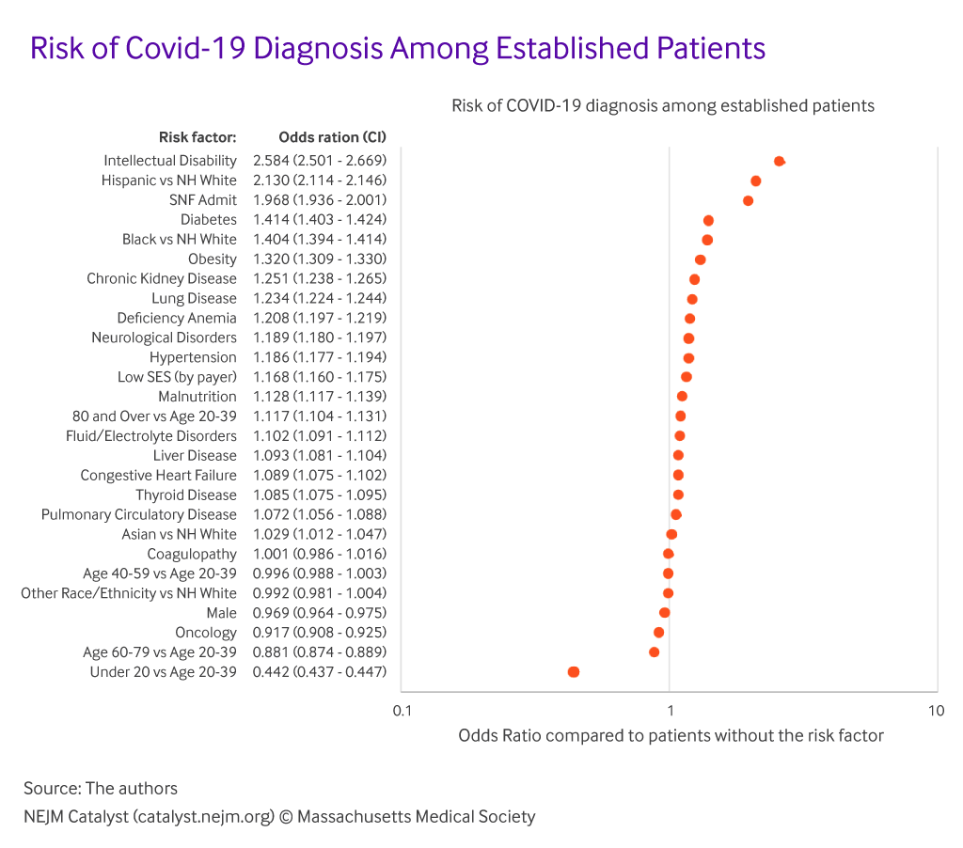

Slide 37
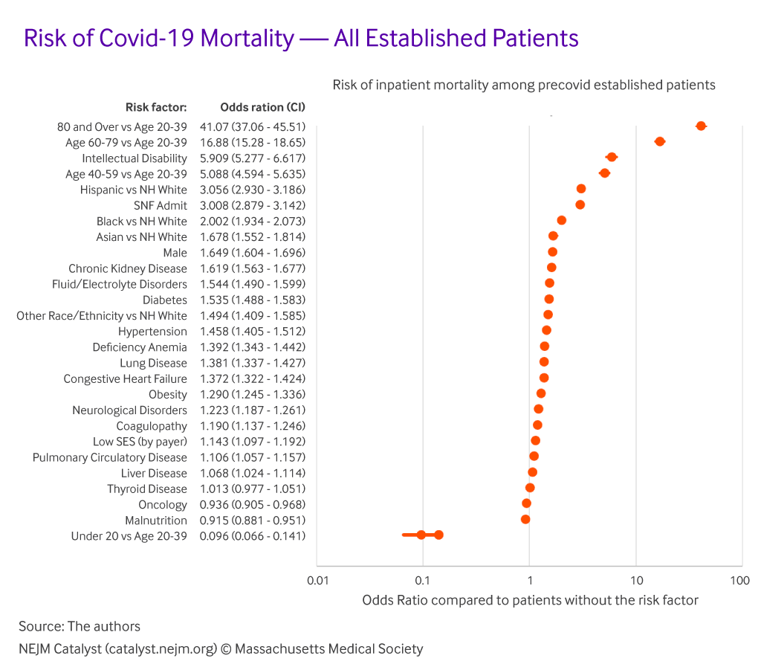

Slide 38
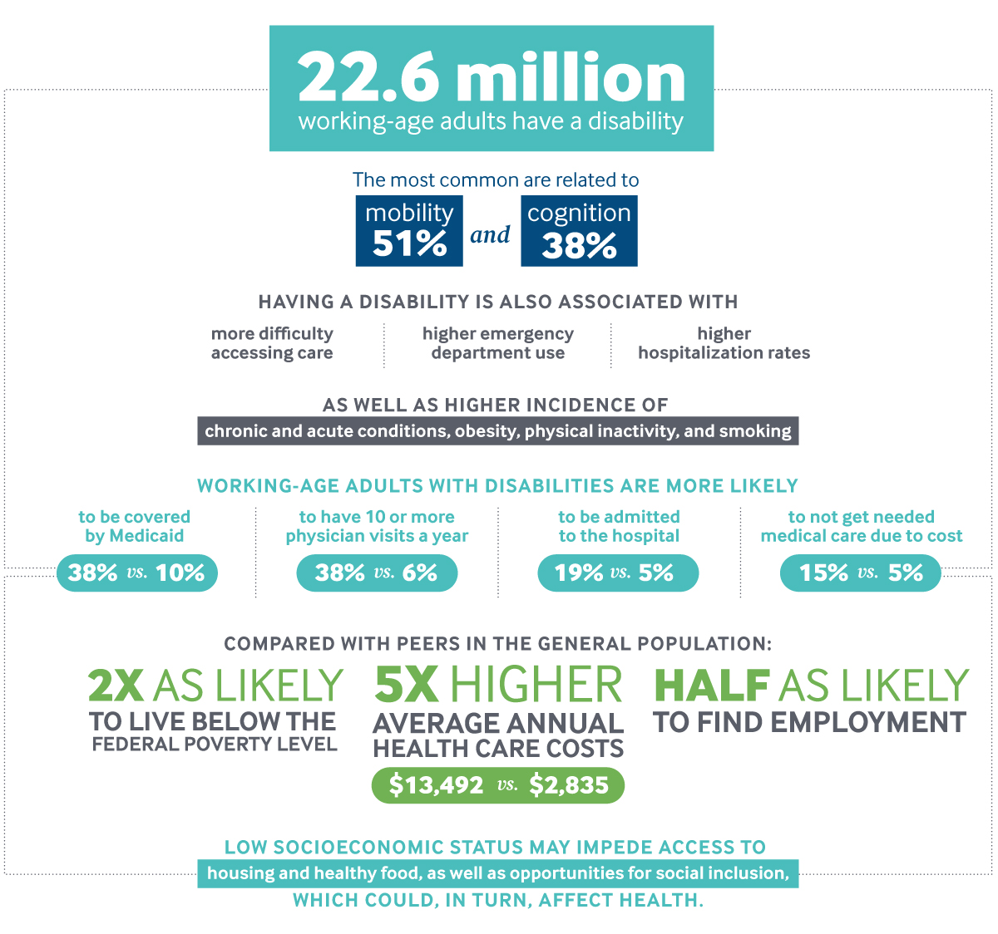

Slide 39
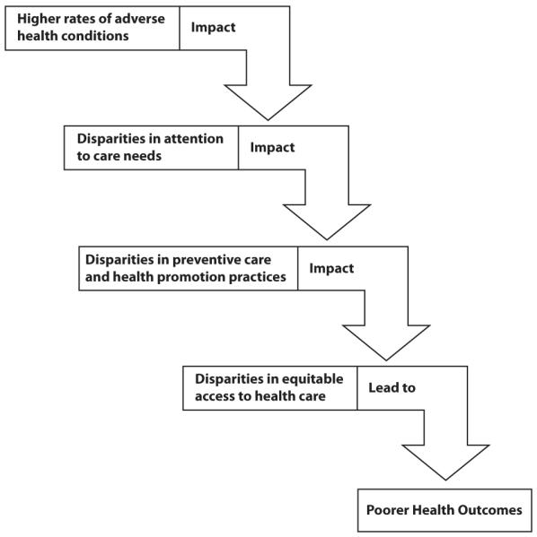
Adverse health conditions conferring risk may be directly related to developmental disability, or related to preventable causes
High rates of co-morbid behavioral and psychiatric problems
Low SES and educational status
Increased contact with others (e.g. daily living support, residential facilities)
Cognitive impairment
Communication difficulties
Decreased adherence to treatment
Lack of experienced providers
Low support in the health care system

Slide 40
Outline
Defining and exploring Developmental Disabilities
Clinical overview of common developmental disabilities
Historical context and current disparity data
Conservatorship/guardianship
Recommendations and resources

Slide 41
Guardianship/Conservatorship
“A conservatorship is a court case where a judge appoints a responsible person or organization (called the “conservator”) to care for another adult (called the “conservatee”) who cannot care for himself or herself or manage his or her own finances.”
“Limited probate conservatorship” for adults with developmental disabilities who cannot fully care for themselves of their finances
Conservatorship can be granted over different areas, including:
Residence
Access to records
Contracts
Medical treatments
Education and vocation
Financial
Romantic/sexual

Slide 42
Does Guardianship Improve Health Outcomes?
People with guardians are less likely to make life decisions including where to live (46% vs 69%), who to live with (34% vs 56 %), daily schedule 80% vs 90%), and how to spend money (87% vs 94%)
Being subject to guardianship can result in lower adaptive functioning and poorer physical and emotional health (NCD 2018)
Those with guardians are less likely to have preventative care
Those without guardians are more likely to work, live independently, have friends outside of family, and socialize in the community
“Most people with intellectual and developmental disabilities (IDD)* can manage their own affairs with assistance and guidance from others, such as family and friends. If guardianship** is necessary, it should be tailored to the person’s needs. Strict monitoring must be in place to protect the best interests and preferences of each person.” (AAIDD)

Slide 43
Alternative for Guardianship—Supported Decision Making
A way for an adult with a disability to make his or her own decisions, by using friends, family members, professionals, and other people he or she trusts to
Help understand the issues and choices
Ask questions
Receive explanations in language he or she understands
Communicate his or her to others.
People with greater self-determination are
More independent
More integrated into their communities
Healthier
Better able to recognize and resist abuse

Slide 44
Outline
Defining and exploring Developmental Disabilities
Clinical overview of common developmental disabilities
Historical context and current disparity data
Conservatorship/guardianship
Recommendations and resources
Individual practices
Education and training
Clinical systems and policy

Slide 45
General Recommendations for Health Care Providers
Ensure clinical settings have full access accommodations (ADA Compliance)
Tailor approach to identify and treat unique needs
Earn trust of the patient
Include patients in care planning, with supported decision making if possible
Make sure to evaluate for mental health concerns
Yearly surveillance visits to check on common health issues
Establish the best method of communication for the patient

Slide 46
Communication is Key
Communication skills and styles may vary
Expressive skills may not match receptive skills
Verbal intelligence may not match non-verbal ability
Visual aides/supports may be helpful to some
Concrete, simple language may be helpful to some

Slide 47
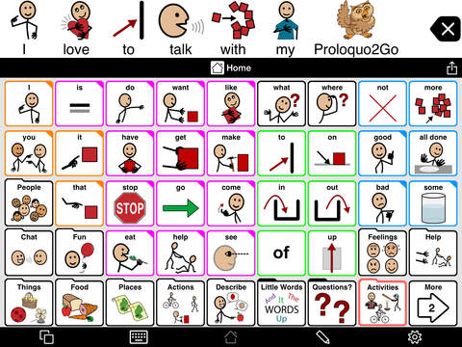
Communication is Key
Communication skills and styles may vary
Expressive skills may not match receptive skills
Verbal intelligence may not match non-verbal ability
Visual aides/supports may be helpful to some
Concrete, simple language may be helpful to some

Slide 48
Neurodiversity model
Medical model: disability vs ability
Neurodiversity: value neurologic differences similar to diversity in gender, race/ethnicity, etc.
First used by Judy Singer in 1990s, a sociologist diagnosed with “Asperger Syndrome”
Based on principle of biodiversity as healthy and necessary
The goal should not be “cure” but acceptance, support, and accommodation
“Shift mainstream perceptions of marginalized NeuroMinorities
Replace negative, deficit-based stereotypes of NeuroMinorities with a more balanced valuation of their gifts and needs
Find valued roles for neurologically marginalized people
Show that all society benefits from the incorporation of NeuroMinorities”
Criticism: rejection of medical model means those with severe impairments should not receive treatments
Counter-criticism: treatments to increase adaptive skills are not incongruent with neurodiversity

Slide 49
Neurodiversity model
Medical model: disability vs ability
Neurodiversity: value neurologic differences similar to diversity in gender, race/ethnicity, etc.
First used by Judy Singer in 1990s, a sociologist diagnosed with “Asperger Syndrome”
Based on principle of biodiversity as healthy and necessary
The goal should not be “cure” but acceptance, support, and accommodation
“Shift mainstream perceptions of marginalized NeuroMinorities
Replace negative, deficit-based stereotypes of NeuroMinorities with a more balanced valuation of their gifts and needs
Find valued roles for neurologically marginalized people
Show that all society benefits from the incorporation of NeuroMinorities”
Criticism: rejection of medical model means those with severe impairments should not receive treatments
Counter-criticism: treatments to increase adaptive skills are not incongruent with neurodiversity

Slide 50
Neurodiversity model
Medical model: disability vs ability
Neurodiversity: value neurologic differences similar to diversity in gender, race/ethnicity, etc.
First used by Judy Singer in 1990s, a sociologist diagnosed with “Asperger Syndrome”
Based on principle of biodiversity as healthy and necessary
The goal should not be “cure” but acceptance, support, and accommodation
“Shift mainstream perceptions of marginalized NeuroMinorities
Replace negative, deficit-based stereotypes of NeuroMinorities with a more balanced valuation of their gifts and needs
Find valued roles for neurologically marginalized people
Show that all society benefits from the incorporation of NeuroMinorities”
Criticism: rejection of medical model means those with severe impairments should not receive treatments
Counter-criticism: treatments to increase adaptive skills are not incongruent with neurodiversity

Slide 51
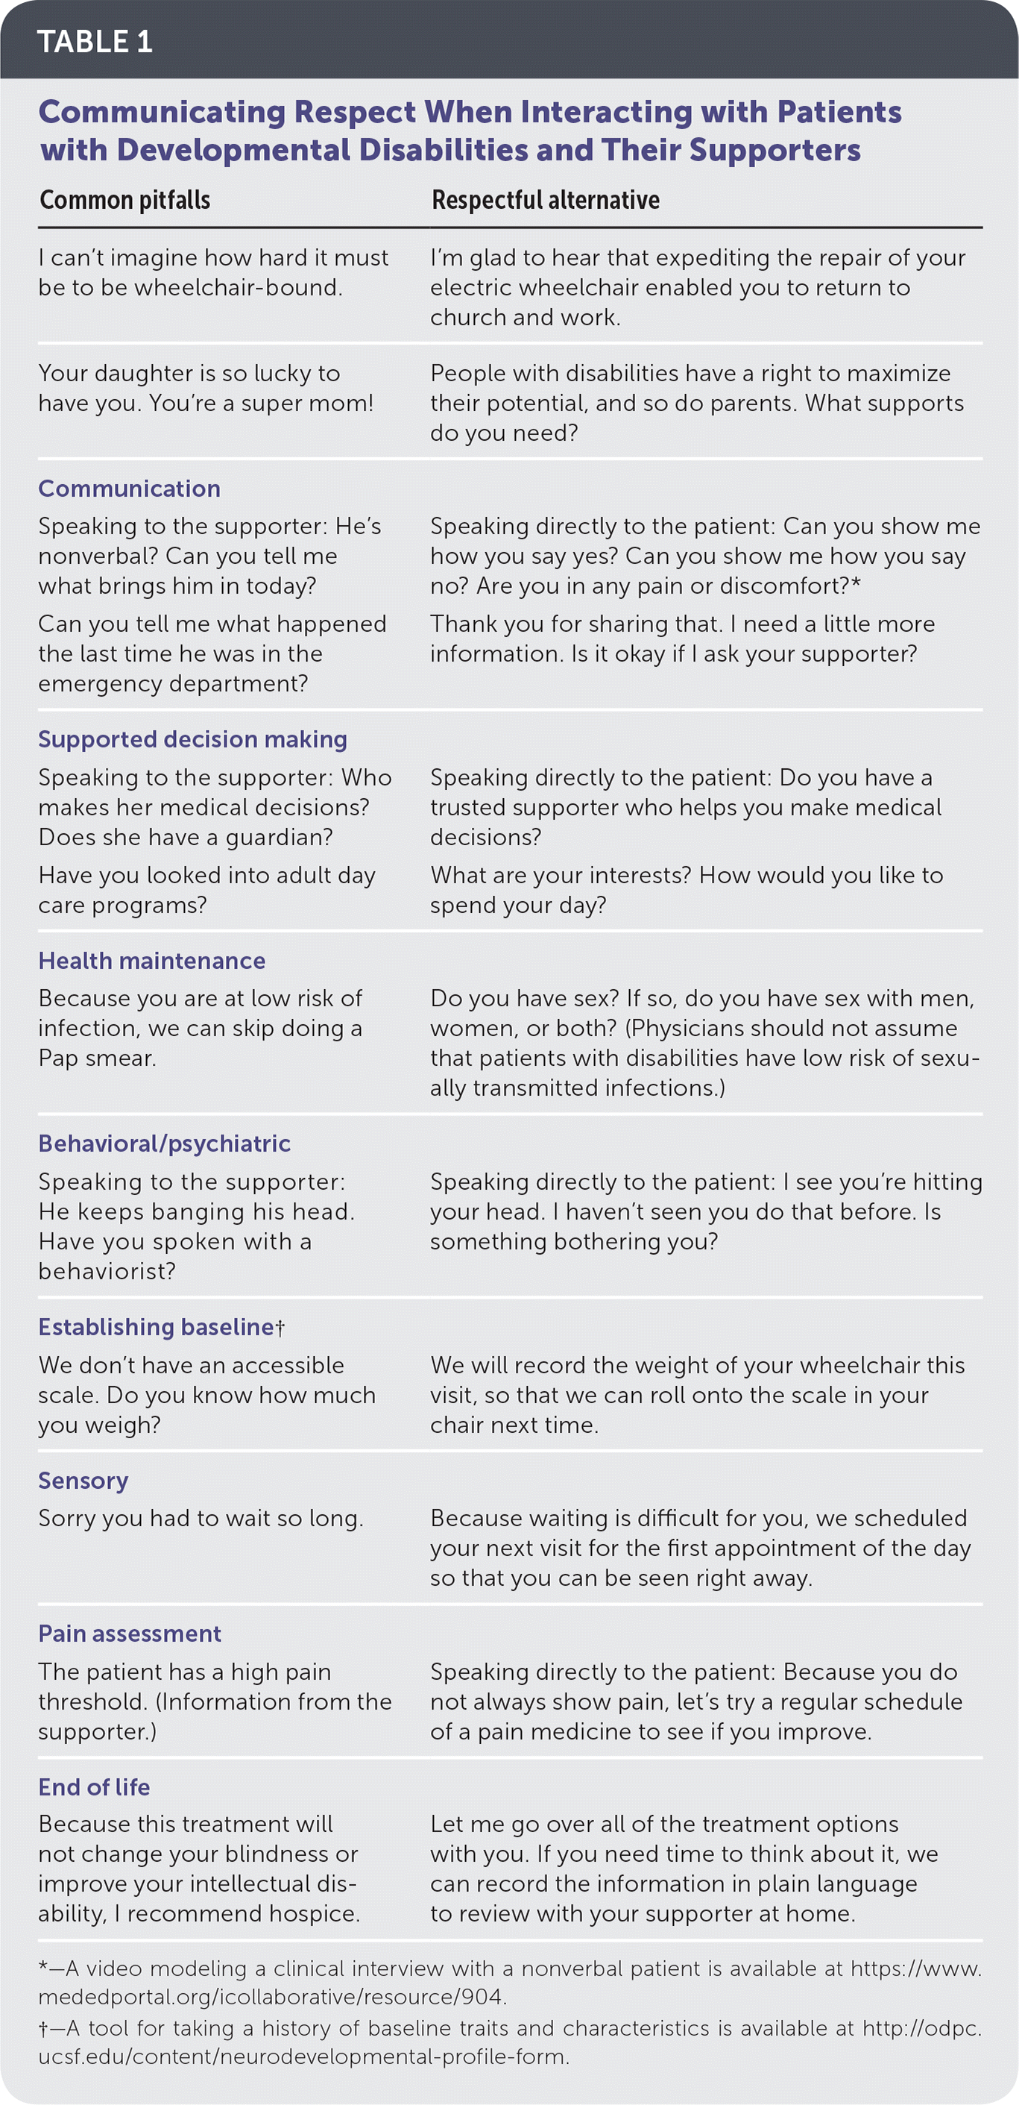

Slide 52
AASPIRE Healthcare Toolkit: Personalized Accommodation Report
Information to assist with patient communication
Customized recommendations to
help the visit go smoothly
help with physical exam
assist with shared decision making
help increase adherence
Heathcare Power of attorney, if applicable

Slide 53
Other Resources
American Academy for Cerebral Palsy Developmental Medicine: care pathways, fact sheets, systematic reviews http://www.aacpdm.org/publications/care-pathways
Autistic Self Advocacy Network: resources for accessing home and community-based services and resources on nondiscrimination, transition, communication, and exercising rights http://autisticadvocacy.org/
Coalition for Compassionate Care of California: advance care planning for persons with developmental disabilities http://coalitionccc.org/tools-resources/people-with-developmental-disabilities/
Health Care for Adults with Intellectual and Developmental Disabilities: clinical algorithms http://vkc.mc.vanderbilt.edu/etoolkit/
Massachusetts Department of Developmental Services: 2017 adult screening recommendations http://www.mass.gov/eohhs/docs/dmr/reports/health-screening-wallchart.pdf
National Institute of Dental and Craniofacial Research: information about providing dental care for persons with developmental disabilities https://www.nidcr.nih.gov/OralHealth/Topics/DevelopmentalDisabilities/
University of California, San Francisco, Office of Developmental Primary Care: chart forms, training materials, practice pearls http://odpc.ucsf.edu

Slide 54
Core Competencies for Health Care Education
Acquire a conceptual framework of disability in the context of human diversity, the lifespan, wellness, injury and social and cultural environments.
Demonstrate mastery of general principles of professionalism, communication, respect for patients, and recognizes optimal health and quality of life from the patient’s perspective.
Understand and identify legal requirements for providing health care in a manner that is, at minimum, consistent with federal laws such as the Americans with Disabilities Act (ADA), Rehabilitation Act, and Social Security Act to meet the individual needs of people with disabilities.
Engage and collaborate with team members within and outside their own discipline to provide high quality, interprofessional team-based health care to people with disabilities.
Collect and interpret relevant information about the health and function of patients with disabilities to engage patients in creating a plan of care that includes essential and optimal services and supports.
Knowledgeable about effective strategies to engage patients with disabilities in creating a coordinated plan of care with needed services and supports.

Slide 55
Policy/Systems Issues
Improved access to health care and human ervices
Increased data for decision-making
Improved health care workforce capacity
Explicit inclusion in public health programs
Increased emergency preparation
Transitional care (pediatric to adult) support
Krahn 2015

Slide 56
Discussion

Slide 57
References (1/2)
Alliance for Disability in Health Care Education. Core Competencies on Disability for Health Care Education. June 2019. https://nisonger.osu.edu/wp-content/uploads/2019/08/post-consensus-Core-Competencies-on-Disability_8.5.19.pdf Accessed online on 1/6/22.
Anagnostou E and Taylor MJ. Review of neuroimaging in autism spectrum disorders: what we have learned and where we go from here. Mol Autism. 2011; 2:4.
Arnstern AFT. The emerging neurobiology of attention deficit hyperactivity disorder: the key role of the prefrontal association cortex. J Pediatr. 2009 May 1; 154(5): I-S43.
Barbaresi WJ, et al. Society for Developmental and Behavioral Pediatrics Clinical Practice Guideline for the Assessment and Treatment of Children and Adolescents with Complex Attention-Deficit/Hyperactivity Disorder. Journal of Developmental & Behavioral Pediatrics: February/March 2020, Vol 41, 235-57.
Benner JL et al. Outcomes in adults with cerebral palsy: systematic review using the International Classification of Functioning, Disability and Health. October 2019. DMCN Vol 61, Issue 10.
Bishop-Fitzpatrick L and Kind AJH. A scoping review of health disparities in autism spectrum disorder. J Autism Dev Disord. 2017 Nov;47(11):3380-3391.
Conrad, JA. On intellectual and developmental disabilities in the United States: A historical perspective. J Intellec Disabil. 2020 Mar;24(1):85-101.
Girault JB and Piven J. The neurodevelopment of autism from infancy through toddlerhood. Neuroimaging Clin N Am. 2020 Feb; 30(1): 97-114.
Gleason, J., Ross, W., Fossi, A., Blonsky, H., Tobias, J., and Stephens, M. (March 5, 2021). The devastating impact of Covid-19 on individuals with intellectual disabilities in in the United States. New England Journal of Medicine Catalyst: Innovations in Care Delivery. https://catalyst.nejm.org/doi/full/10.1056/CAT.21.0051

Slide 58
References (2/2)
Hyman, SL et al. Identification, evaluation, and management of children with autism spectrum disorder. Pediatrics (2020) 145 (1):e20193447.
Krahn, GL and Fox MH. Health disparities of adults with intellectual disabilities: What do we know? What do we do? Journal of applied research in intellectual disabilities 2014, Vol 27, Issue 5.
Krahn GL, Walker DK, and Correa-De-Araujo R. Persons with disabilities as an unrecognized health disparity population. 2015 American Journal of Public Health 105, S198_S206.
Kuriyan, Aparajita B. et al. (January 2013). Young Adult Educational and Vocational Outcomes of Children Diagnosed with ADHD. Journal of Abnormal Child Psychology 41(1):27–41.
National Council on Disability. (2018). Beyond guardianship: Toward alternatives that promote greater self determination, Washington, D.C. https://ncd.gov/sites/default/files/NCD_Guardianship_Report_Accessible.pdf
Reppermund S, Srasuebkul P, Dean K, Trollor JN. Factors associated with death in people with intellectual disability. J Appl Res Intellect Disabil. 2020 May;33(3):420-429.
Pettersson K and Rodby-Bousquet E. Living conditions and social outcomes in adults with cerebral palsy. Nerol 21 October 2021.
Owens, Elizabeth et al. (2015). Developmental Progression and Gender Differences among Individuals with ADHD. In R. A. Barkley (Ed.), Attention-Deficit Hyperactivity Disorder: A Handbook for Diagnosis and Treatment, 4th ed. (pp. 223-255). New York, NY: Guilford Press.
Vitrikas K and Dalton H. Cerebral Palsy: an Overview. Am Fam Physician. 2020 Feb 15;101(4):213-220

Slide 59
THANK YOU

