Slide 1
Healthcare for Every Body – Caring for Higher Weight Patients
With Ragen Chastain
Ragen@SizedForSuccess.com

Slide 2
Introductory Info
Format
Privilege
Permission to share
An Invitation

Slide 3
A Word About Language
Fat
“Obese” and “Overweight”
Origin/BMI
Sabrina Strings – Fearing the Black Body
Da’Shaun Harrison – Belly of the Beast
Impact
Profit to weight loss industry
Stigma and oppression to people in classifications
Fractured relationships between higher weight patients and HCPs
Person First Language
Person with obesity, person with overweight
Higher Weight, People of Size, Larger Bodies

Slide 4
Size Acceptance
Civil Rights Movement - the rights to life, liberty and the pursuit of happiness are not size dependent
People have the right to exist in bodies of all sizes without shame, stigma, bullying, or oppression
Weight-Neutral Healthcare
Evidence-based paradigm for public health, physical and mental healthcare, and personal health
Recognizes that health is not an obligation, barometer or worthiness, or entirely within our control.
Focus is on removing barriers and creating access, including oppression, social determinants of health, rather than not body size manipulation.

Slide 5
Weight Stigma and the Weight Loss Paradigm

Slide 6
Definition of Intentional Weight Loss
Intentional Weight Loss
Any attempt to purposefully decrease body size based on the idea that a thinner body is better/healthier than a fatter body
IWL Includes
Using food and/or movement and may be called: dieting, lifestyle change, health plan, nutrition plan etc.

Slide 7
In Summary - The Truth about Weight Loss
“There isn’t even one peer-reviewed controlled clinical study of any intentional weight-loss diet that proves that people can be successful at long-term significant weight loss. No commercial program, clinical program, or research model has been able to demonstrate significant long-term weight loss for more than a small fraction of the participants. Given the potential dangers of weight cycling and repeated failure, it is unscientific and unethical to support the continued use of dieting as an intervention for obesity.”
--Wayne Miller, George Washington University

Slide 8
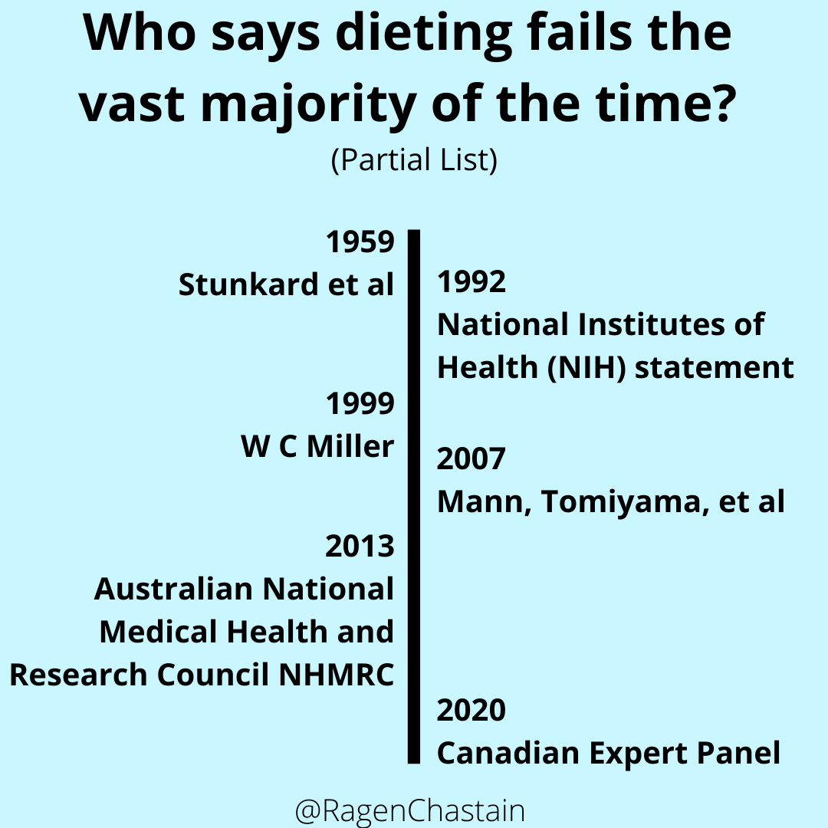

Slide 9
What The Research Actually Finds
Almost everyone loses weight short-term (1 year)
About 95% regain weight long-term (2-5 years)
Up to 66% of people regain more weight than they lost

Slide 11
How the research misleads us
Short-term focus
Ignores drop-out rates
Poor design/inappropriate conclusions
Example: Weight Watchers
Research: Average client loses 10 pounds in year 1, gains back 5 in year 2
Chief scientific officer: “It’s nice to see this validation of what we’ve been doing.”

Slide 12
Basic Premise Error Part 1
If higher weight patients experience a health issue more often than thinner patients, then their body size is to blame
Testing rate
Confounding variables
Correlation/Causation

Slide 13
Case Study– H1N1
During the 2009 H1N1 outbreak, there was a strong correlation between fatness and negative outcomes
After the outbreak a study was conducted. It found that thin people were given earlier antiviral treatment than fat people and that “After adjustment for early antiviral treatment, relationship between obesity and poor outcomes disappeared.”
Sun et. al. Weight and prognosis for influenza A(H1N1)pdm09 infection during the pandemic period between 2009 and 2011: a systematic review of observational studies with meta-analysis

Slide 14
The Basic Premise Error Part 2
If higher weight patients experience a health condition more often, or if a healthcare intervention is less effective for them, the solution is to make them into thin(ner) patients
People of the same weight have different health statuses and vice versa
Weight changes without health changes/health changes without weight changes
The war on baldness
Success rate of intentional weight loss interventions
Patients need help now – not at some indeterminate, hypothetical time in the future

Slide 15
A Lack of Control

Slide 16
Control Error – The Effects of Weight Stigma
Dr. Peter A. Muennig, Professor of Health at Columbia University
“Women who say they feel they are too heavy
suffer more mental and physical illness than
women who say they feel fine about their size —
no matter what they weigh.”
“Stigma and prejudice are intensely stressful. Over
time, such chronic stress can lead to high blood
pressure and diabetes.”

Slide 17
Control Error 2: Effects of Weight Cycling
The risks associated with weight cycling are very much the same as those associated with obesity
-Gaesser and Angadi, Obesity treatment: Weight loss versus increasing fitness and physical activity for reducing health risks
“Attempts to lose weight typically result in weight cycling…weight cycling results in increased inflammation, which in turn is known to increase risk for many obesity-associated diseases. Research also indicates that weight fluctuation is associated with poorer cardiovascular outcomes and increased mortality risk.”
“Weight cycling can account for all of the excess mortality associated with obesity in both the Framingham Heart Study and the National Health and Nutrition Examination Survey (NHANES).”
-Bacon and Aprhramor, Weight Science: Evaluating the Evidence for a Paradigm Shift

Slide 18
Lack of Access To Ethical, Evidence-Based Health Care
Control Error 3 – Healthcare Access
Research
Accommodation
chairs, tools, durable medical equipment
Training
Practitioner Bias – Implicit and Explicit
Two underlying beliefs
It’s worth risking fat people’s lives and quality of life in attempts to make them thin
It’s acceptable to insist that fat people become thin before they can access ethical, evidence-based medicine

Slide 19
Practitioner Bias
Over 50% of doctors found their “obese” patients awkward, ugly, weak-willed and unlikely to comply with treatment.
28% of nurses were “repulsed” by “obese” patients
12% of nurses said that they did not want to touch “obese” patients
--Rebecca Puhl, Yale University
31% of nurses indicated they would prefer not to treat patients who are “obese”
--Maroney et al
Ease of information gathering

Slide 20
A Matter of Respect
“The higher a patient’s body mass, the less
respect doctors express for that patient. And
the less respect a doctor has for a patient, the
less time the doctor spends with the patient
and the less information he or she offers.”
Dr. Mary Huizinga, Assistant Professor
Johns Hopkins School of Medicine

Slide 21
Weight Stigma In the Research

Slide 22
Case Study – Herriot et. al
Dietetic literature on weight management fails to meet the standards of evidence-based medicine
Herriot et. al: A qualitative investigation of individuals' experiences and expectations before and after completing a trial of commercial weight loss programs.
Conclusion: “all diets in 'Diet Trials' were ultimately successful in achieving weight loss in those who complied” (p 78)
Truth: 64% of subjects had withdrawn by week 8; some people gained weight; weight rebound was common
Aphramor, Validity of claims made in weight management research: a narrative review of dietetic articles

Slide 23
Case Study: Lucia et. al.
CNN Headline: 'Fat but fit' is a myth when it comes to heart health, new study shows
Study Author Alejandro Lucia, a professor of exercise physiology
"One cannot be 'fat but healthy.' This was the first nationwide analysis to show that being regularly active is not likely to eliminate the detrimental health effects of excess body fat“
Study actually concluded that any level of activity lowered the three risk factors compared with no exercise, with the risk of high blood pressure and diabetes decreasing with increased activity levels for people of all sizes
The study showed greater cardiovascular risk for higher weight patients compared with those of a “normal” weight, regardless of how much exercise they did
Lucia: "Weight loss should remain a primary target for health policies together with promoting active lifestyles”

Slide 24
What About Surgeries and Diet Drugs

Slide 25
Weight Loss Surgeries
What it Is
Take a healthy, correctly functioning organ/digestive system
Surgically put it into an often irreversible disease state
Force behaviors that mimic eating disorders
Possible Outcomes
Happy
Miserable
Deceased
Underlying Belief
Fat people should be willing to risk their lives and quality of life in an attempt to become thin(ner)…
…to cure/prevent health problems that happen to thin people, from whom these risks aren’t asked

Slide 26
Risks of Weight Loss Surgery – Side Effects Ernsberger and Swarzc
potassium loss
pulmonary embolus
putrid breath and stomach odor
rectal bleeding
intestinal shrinkage
stomach pain
sleep irregularities
suicidal through’s
thyroid malfunction
urinary trace infection
vitamin and mineral deficiency
vitamin and mineral malabsorption
violent hiccups that persist dail
vomiting from blockage
vomiting from drinking too fast
vomiting from eating too fast
vomiting from eating too much (more than 2 ounces,
weight regain
Nausea
neural tube defects in children
neurological impairment
Osteoporosis
pancreas impairment
left side pain
digestion pain
evacuation pain
peeling of fingernails
potassium loss
pulmonary embolus
putrid breath/stomach odor
pancreas impairment
left side pain
digestion pain
evacuation pain
peeling of fingernails
Adhesions and polyps
massive scar tissue
advanced aging
Anemia
Arthritis
Blackouts
bloating,
body odor like rotten meat
Bowel impaction
chest pains
impaired circulation
col intolerance
Constipation
Depression
Diarrhea
digestive impairment
digestive irregularities
Diverticulitis
drainage problems at incision
early onset of diabetes
early onset of hypertension
electrolyte imbalance
erosion of tooth enamel
excessive drive skin
excessive stomach acid
esophageal contractions
esophageal erosion and scarring
feeling ill
gallbladder distress
gynecological complications
hair loss, hemorrhoids
Hernia
hormone imbalances
impaired mobility
infection
infertility
intestinal atrophy
intestinal gas
involuntary anorexia
lumpy body syndrome
iron deficiency
kidney impairment and failure
liver impairment and failure
low energy
loss of muscle control
loss of skin integrity
low hemoglobin
lowered immunity
pituitary gland malfunction
muscle cramps

Slide 27
Risks of Weight Loss Surgery - Death
Up to 4.6% of patients died within a year, 6.4% by the end of the fourth year, 13% after 9 years
Many deaths unaccounted for
Blamed on body size
“By best estimates, bariatric surgeries likely increase the actual mortality risks for higher weight patients by 7-fold in the first year and by 250-363% in the first four years.” – Sandy Swarzc
Lindo Bacon – Health at Every Size The Surprising Truth About Your Weight

Slide 28
Case Study: Belviq
2009 – The FDA does not approve diet drug Belviq because of potentially life-threatening side effects
2012 - The FDA approves Belviq despite potentially life-threatening side effects

Slide 29
Side Effects
Decreased white and red blood cell count
Slowed heartbeat
Slowed thinking
Heart valve issues
Increased risk of cancer
Federally controlled substance because it may lead to drug dependence
“The precise way BELVIQ® produces feelings of satisfaction is not fully understood”

Slide 30
What are we risking all of this for?
Half the subjects dropped out in the first year, with no follow up
Those remaining lost 5% - 10% of their weight after 12 months
After 25 months they had all gained back around 25% of the weight they had lost
At that point they simply stopped following the patients and claimed “All people regained weight but remained below their starting weight.”

Slide 31
Gaesser and Angadi
Analyzed 225 studies, systematic reviews, and meta-analyses
The mortality risk associated with ob*sity is largely attenuated or eliminated by moderate-to-high levels of cardiorespiratory fitness (CRF) or physical activity (PA)
Most cardiometabolic risk markers associated with ob*sity can be improved with exercise training independent of weight loss and by a magnitude similar to that observed with weight-loss programs
Weight loss, even if intentional, is not consistently associated with lower mortality risk

Slide 32
Gaesser and Angadi
Increases in CRF or PA are consistently associated with greater reductions in mortality risk than is intentional weight loss
Weight cycling is associated with numerous adverse health outcomes including increased mortality.
Adherence to PA may improve if health care professionals consider PA and CRF as essential vital signs and consistently emphasize to their patients the myriad benefits of PA and CRF in the absence of weight loss.

Slide 33
Weight Stigma Patient Impacts

Slide 34
Lived Experience Delayed/Denied Care
Sandy’s Sudden Onset Back Pain
Charla’s Eat Less and Exercise More
A very difficult prescription
Ellen Maude Bennett

Slide 35
Impacts of Weight Stigma in Practitioner/Patient Relationship
Patient Disengagement
Lack of early detection/screenings
Mistrust of other practitioner recommendations
Practitioner weight distraction
See the patient as a pathology
Missed diagnoses and recommendations
Dieting prescriptions and delayed care
Practicing stereotypes instead of medicine

Slide 36
Weight Stigma and Accommodation
Lack of Accommodation
Spaces
Diagnostic Tools
Durable Medical Equipment
Research and Pharmaceutical Support
Acceptability of Inequality
If fatness can be blamed, then inequality is acceptable

Slide 37
Case Study – Joint Replacement
Current Belief
Fat patients have more complications and worse outcomes
Current Solution:
Deny surgeries until BMI thresholds are met
Deny needed surgery as “too high risk,” recommend weight loss surgery
Possible other solutions
Solve inequalities (techniques, delays, etc.)
Patient-informed risk/benefit analysis
Look to the current research

Slide 38
Case Study – Joint Replacement
Inacia et. al, The risk of surgical site infection and re-admission…
Study of Kaiser members shows worse outcomes with intentional weight loss before surgery
Smith et. al., Does bariatric surgery prior to total hip or knee replacement reduce post-operative complications
Weight loss surgery does not improve surgical complication rates
Cao et. al, Obesity does not increase blood loss or incidence of immediate postoperative complications …
Obesity does not increase blood loss or incidence of immediate postoperative complications
Wenjun et.al., Functional Gain and Pain Relief After Total Joint Replacement According to Obesity Status
"Our data shows it's not necessary to ask patients to lose weight prior to surgery…severe morbidly obese patients can benefit almost equally as normal weight patients in pain relief and gains in physical function.”

Slide 39
The Cycle of Weight Stigma in Healthcare
The current system:
creates and perpetuates weight stigma leading to weight cycling, and serious inequalities in access to, and quality of, healthcare for higher weight patients
Then blames higher weight patients for the negative outcomes that result
Then uses those negative outcomes to justify additional weight stigma

Slide 40
Thought to ponder
We have no idea what fat people’s health outcomes would look like
if they were not subjected to weight stigma, weight cycling, and healthcare inequalities

Slide 41
Moving Forward

Slide 42
Weight-Neutral Interventions
are
Evidence-Based Medicine

Slide 43
Health at Every Size Myths and Misconceptions
Health at Every Size says that if you love your body then you will be healthy
HAES says everyone deserves to love their body, regardless of health
HAES says everyone can be healthy at any size
There are people of all sizes across the health spectrum, HAES points out that the evidence supports weight-neutral interventions for people of all sizes

Slide 44
Health at Every Size Myths and Misconceptions
There is a point at which someone becomes too fat for HAES
It’s ok to be fat as long as you’re healthy, able-bodied, etc.
Healthism, Ableism, Fatphobia
Weight loss almost never works and it gets less likely for the highest weight people
Dangerous drugs and surgeries suggest that larger bodies are less valuable/more riskable.
We should celebrate non-scale victories like changing clothing sizes, and being able to fit on a roller coaster
If you are celebrating body size manipulation, you are still celebrating “scale victories:
If you are celebrating not being oppressed like fatter people are, you are celebrating other people’s oppression

Slide 45
Set Point Theory
Each person has a unique weight range which their body defends
Creates difficulties with intentional weight loss and gain
Intentional Weight Loss attempts can change set point
Famine response

Slide 46
25714 adult cis-men
Source: Wei et al. “Relationship Between Low Cardiorespiratory Fitness and Mortality in Normal-Weight, Overweight, and Obese Men.” JAMA. 1999;282: 1547-1553.)

Slide 47
obese
Health Hazard
Ratio
overweight
normal
Number of Healthy Habits
5 or more servings of fruits and vegetables
Exercise more than 12 times per month
Alcohol up to 1 drink/day for cis-women and up to 2 drinks/day for cis-men
not smoking
Matheson et. al.
Healthy lifestyle habits and mortality in overweight and obese individuals.
11,761 cis men and women

Slide 48
A Change In Focus
Instead of focusing on manipulating the weight of fat patients, focus on supporting their health at their current size
Research
Tools and Equipment
Practitioner Training - compassion, to practice, to advocacy
Best Practices
Include patient perspective/priorities, informed consent

Slide 49
Case Study – Steep Trendelenburg
30 to 40 degree angle – head down
Common in robot-assisted surgeries
Fat bodies can have more trouble tolerating this position
Current Solution:
Try and then convert
Possible solutions
Titrate Angle, lithotomy positioning
Less steep angle - Ghomi et. al
Donna’s situation

Slide 50
Case Study – MRI Machines
Accommodation
Gown
Table
Bore
Fixed or free straps and positioners
All the other issues

Slide 51
Options for Higher Weight Patients
Weigh-in only when medically necessary
Allow patient to decline with no push back, consider signage
Never offer to guess
Look for inequalities and solve them
What would you do for a thin person with this health issue
Would you be happy to document your denial?
Look for information
Has anyone done any research on how to better accommodate fat patients
www.HAESHealthSheets.com
Create list of accommodating options

Slide 52
Even If I’m Wrong
Even if higher weight patients could all become thin
and even if by becoming thinner we would become healthier,
Higher weight patients would still deserve equal accommodation and access to the world, including health care

Slide 53
Q&A
Didn’t want to ask your question in front of the group? Question came to you two weeks (or two years) after the talk?
Email me
Ragen@SizedForSuccess.com
Message me
Instagram: @RagenChastain
Find more resources at
www.HAESHealthSheets.com

